Slide 1


Azubian Expresso Challenge
Powered By Team Switzerland
TELECOMMUNICATIONS CHURN PREDICTOR
A Machine Learning Approach Using the CRISP-DM Framework

Slide 2
Mr. Nfayem Imoro

Slide 3
BUSINESS UNDERSTANDING

Slide 4
Optimizing Customer Retention for Azubian Expresso
Addressing churn for Azubian Expresso in the competitive telecom market.
Predict churn using machine learning to identify customers at risk of inactivity.
Analyse customer data to uncover key churn drivers.
Improve retention through targeted interventions based on insights.
Support long-term growth by reducing churn and enhancing customer satisfaction.
Notes:
- **Project Background:**
Addressing customer churn is crucial for Azubian Expresso, a telecom company in Africa. This project aims to use machine learning to predict churn, helping the company retain customers and enhance profitability.
- **Objective:**
Develop machine learning models to predict customer churn, specifically identifying customers who may become inactive within 90 days.
- **Focus:**
Analyze customer metrics and behaviors to understand churn drivers and provide actionable insights.
- **Outcome:**
Enable targeted interventions to improve customer retention and satisfaction.
- **Impact:**
Equip Azubian Expresso with data-driven strategies to reduce churn rates and support long-term business growth.

Slide 5
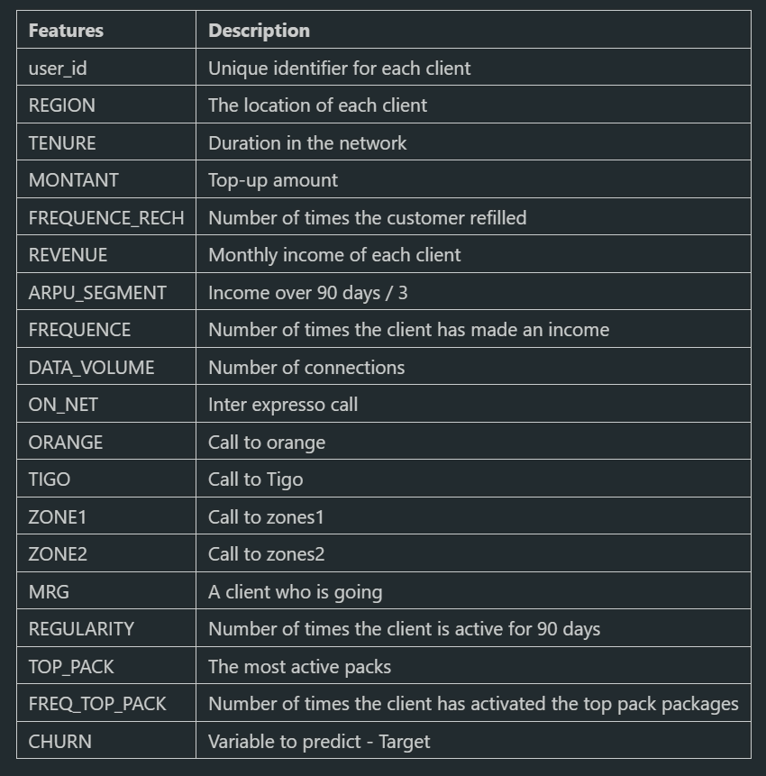
Description of Features for Churn Prediction
Customer Information
Usage Patterns
Revenue and Revenue Generation
Activity Churn Indicators
Target Variable
Feature Engineered Variable
Notes:
- **Customer Information:** Identifies and categorizes customers, including unique IDs and geographical regions.
- **Usage Patterns:** Tracks customer behavior such as tenure, refill frequency, data usage, and communication patterns.
- **Revenue and Revenue Generation:** Covers financial metrics like monthly income, average revenue per user, and revenue generation frequency.
- **Activity Churn Indicators:** Measures activity consistency and potential churn indicators based on recent engagement.
- **Target Variable:** Indicates whether a customer has churned or not.
- **Feature Engineered Variable:** Estimates recent customer activity by integrating various engagement features to predict churn risk.

Slide 6
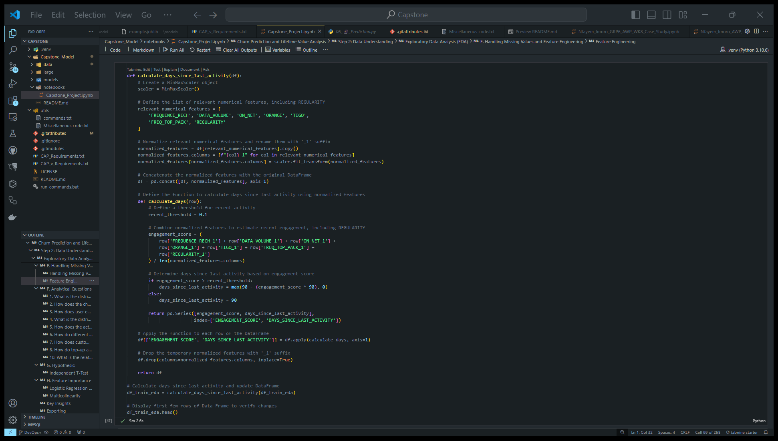
Engineered Features
ENGAGEMENT SCORE
DAYS_SINCE_LAST_ACTIVITY

Slide 7
DATA UNDERSTANDING

Slide 8
Mr. Moriah Asare

Slide 9
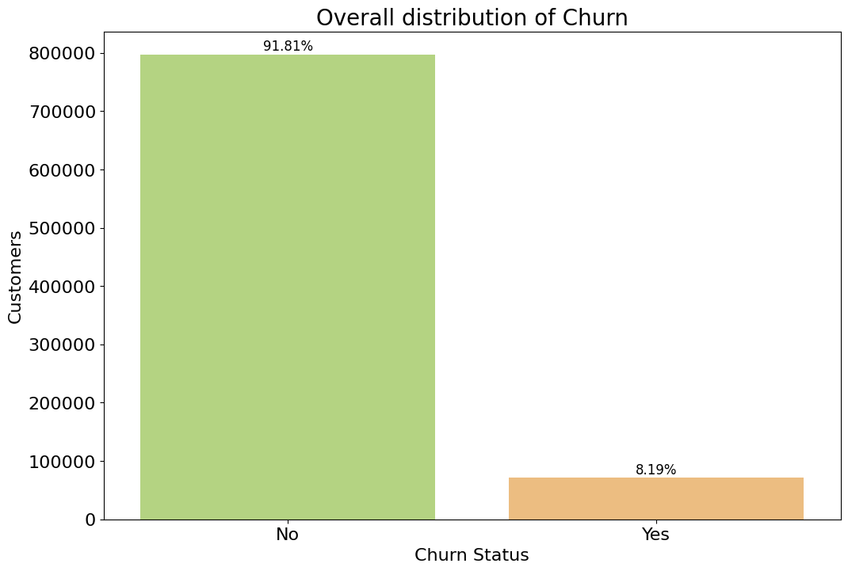
What is the distribution of Churn?
To understand the overall churn rate in the dataset, providing a baseline for further analysis and highlighting the extent of the churn issue.

Slide 10
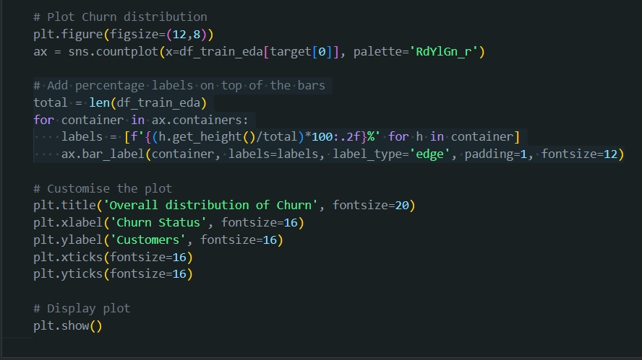
What is the distribution of Churn?

Slide 11
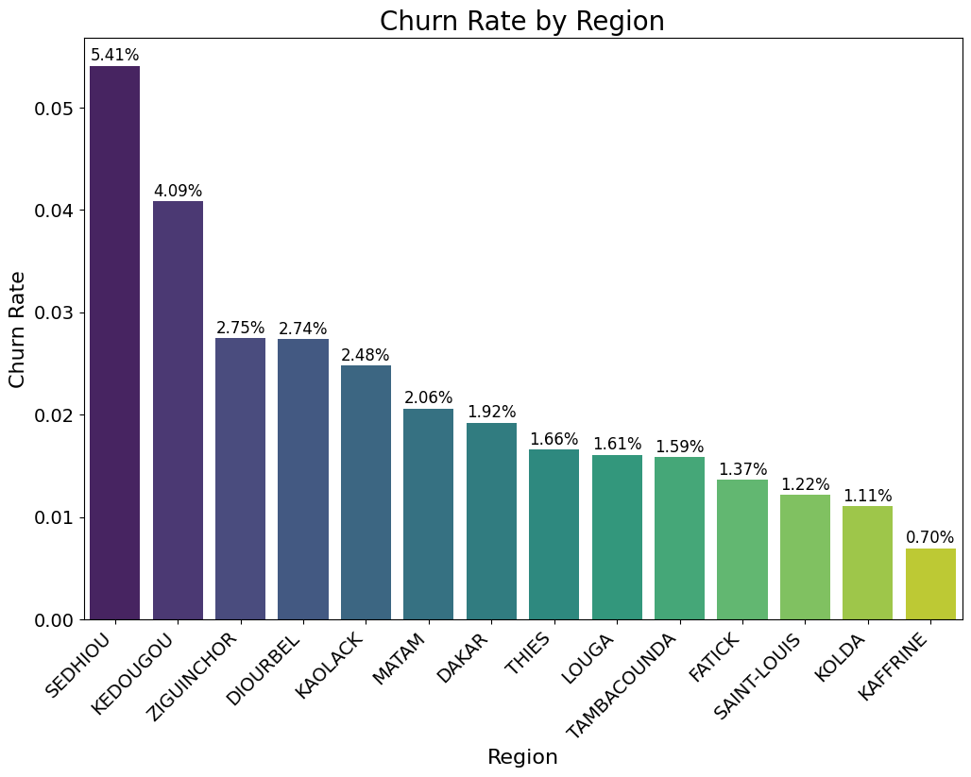
How does the churn rate vary across different regions?
To evaluate how churn rates differ across various regions, helping to identify geographic areas where customer retention efforts may need to be strengthened.

Slide 12
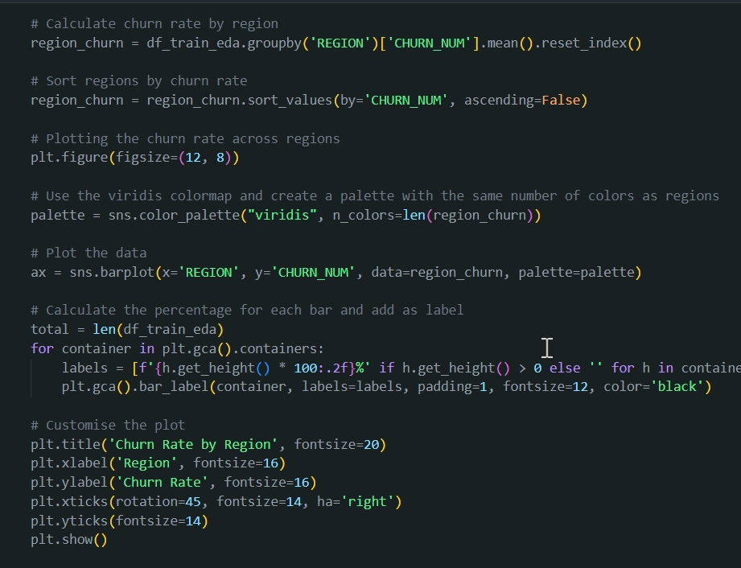
How does the churn rate vary across different regions?

Slide 13
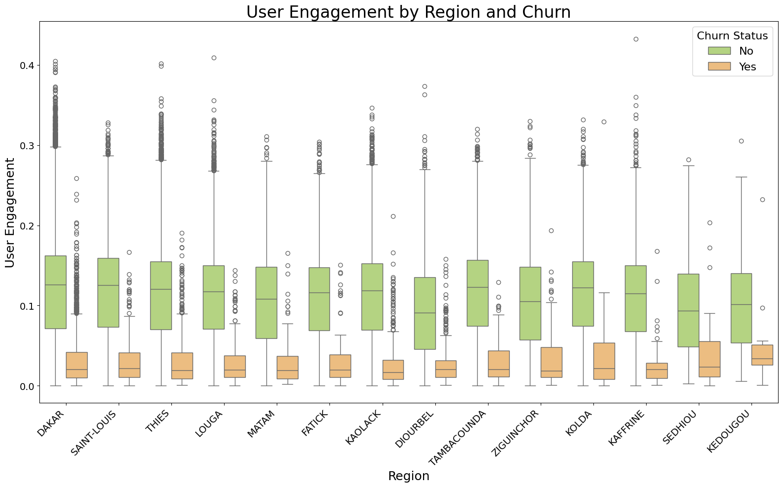
How does user engagement vary with churn across different regions?
To investigate regional variations in overall user engagement by analysing key metrics such as call activities, refill frequency, data volume, top pack activations, and regularity.

Slide 14
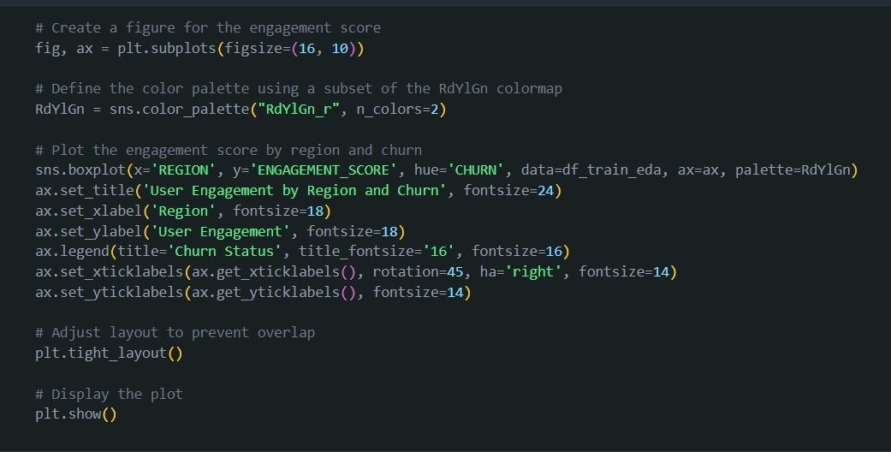
How does user engagement vary with churn across different regions?

Slide 15
Mr. Obed Tettey Korda

Slide 16
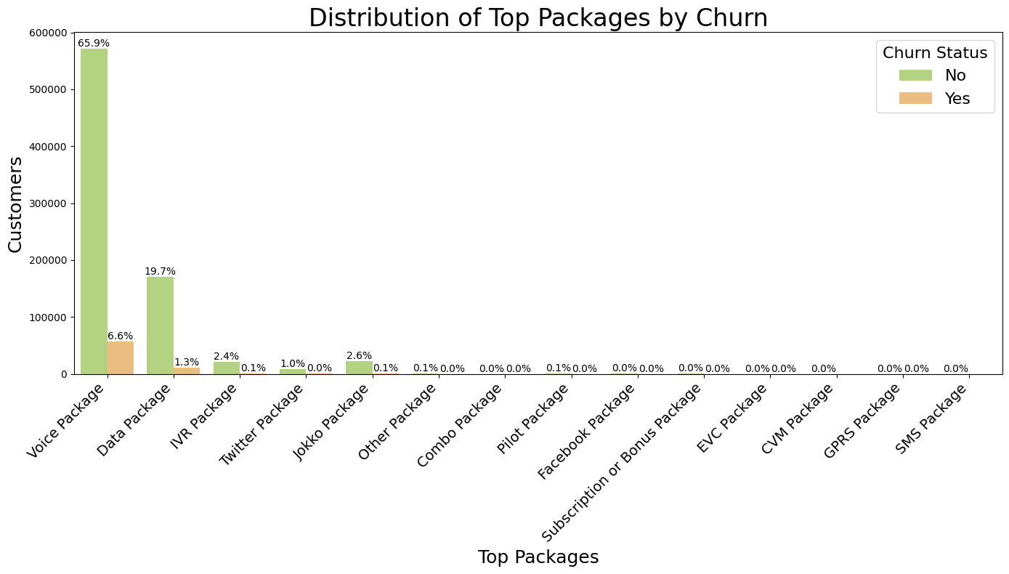
What is the distribution of top packages with customer churn?
To analyse how different types of top packages are distributed across churn and non-churned customers.

Slide 17
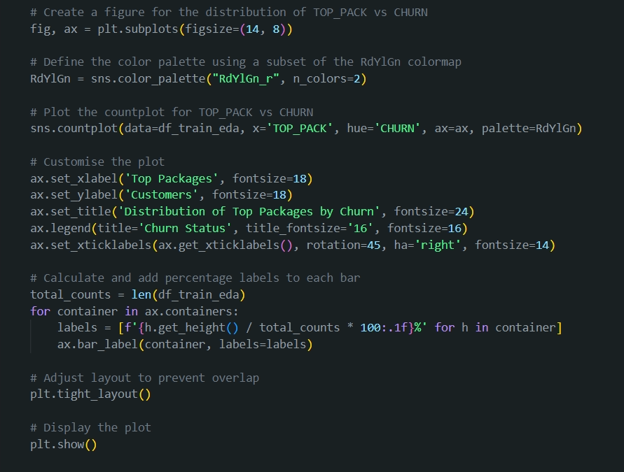
What is the distribution of top packages with customer churn?

Slide 18
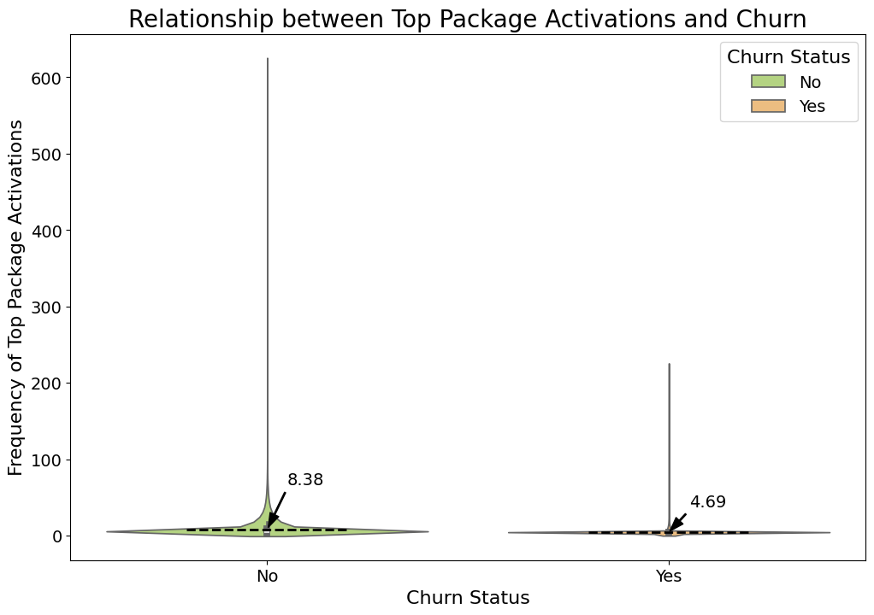
How does the activation of top packages relate to churn rates?
To evaluate if frequent activation of top packages increases customer engagement, potentially reducing churn rates.

Slide 19
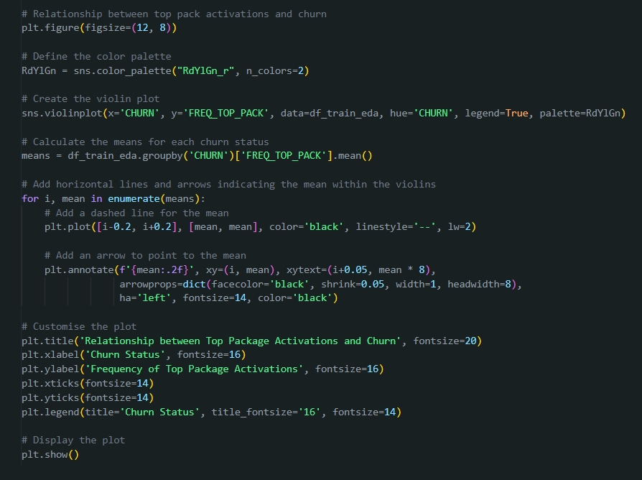
How does the activation of top packages relate to churn rates?

Slide 20
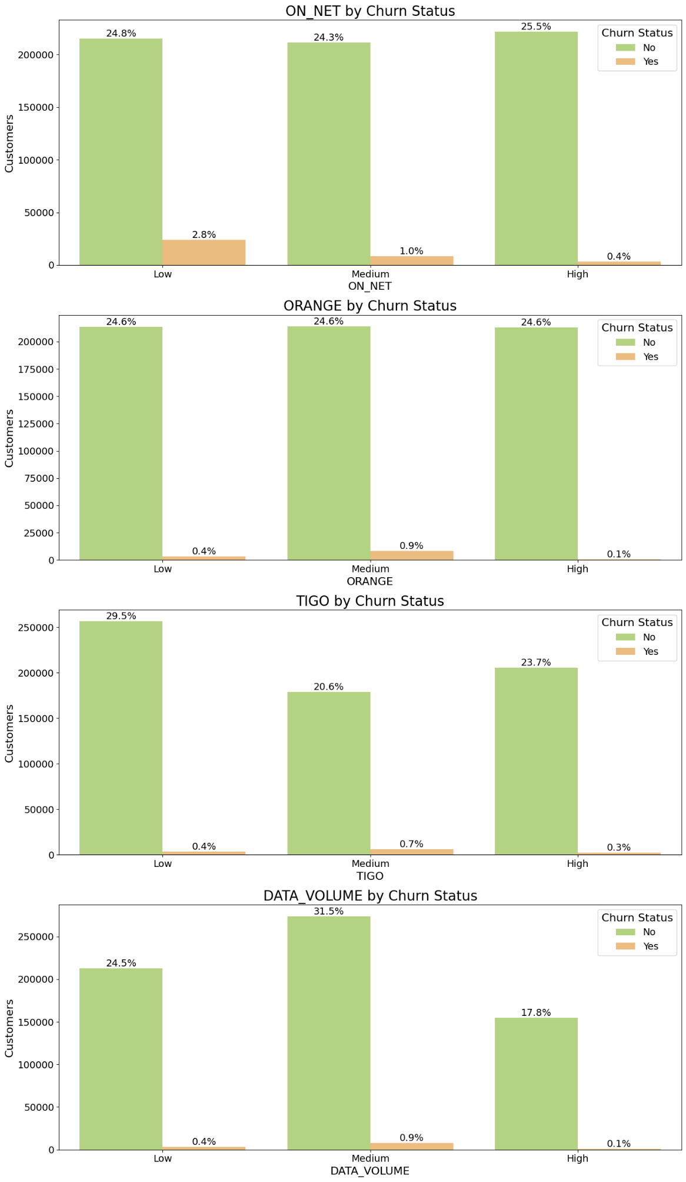
How do different levels of call and data activity relate to customer churn?
To evaluate if varying levels of call and data activity (categorized as Low, Medium, and High) are associated with higher or lower churn rates.

Slide 21
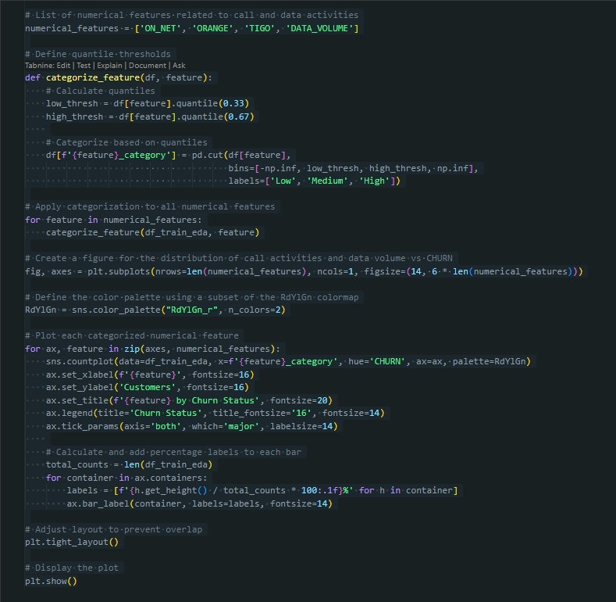
How do different levels of call and data activity relate to customer churn?
Low: Values in the lower third of the data.
Medium: Values between the lower and higher thirds.
High: Values in the higher third of the data.

Slide 22
How do different levels of call and data activity relate to customer churn?

Slide 23
Mr. Godfred Frank Aning

Slide 24
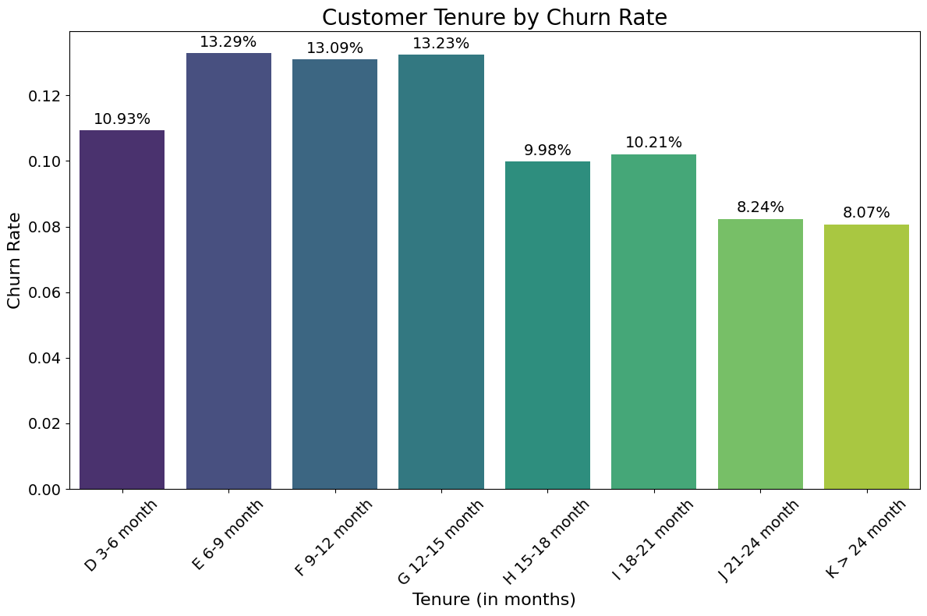
How does customer tenure affect churn rates?
To analyse whether longer-tenured customers exhibit different churn behavior, possibly indicating loyalty or disengagement over time.

Slide 25
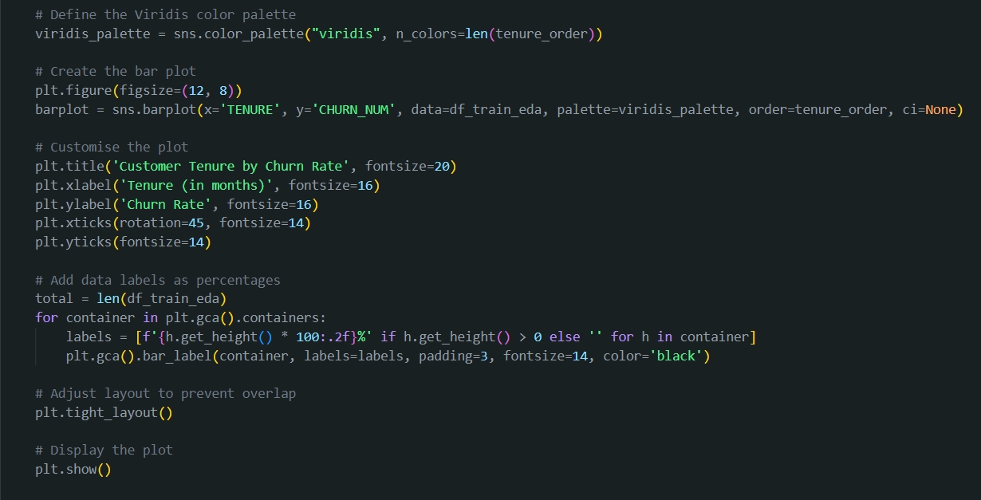
How does customer tenure affect churn rates?

Slide 26
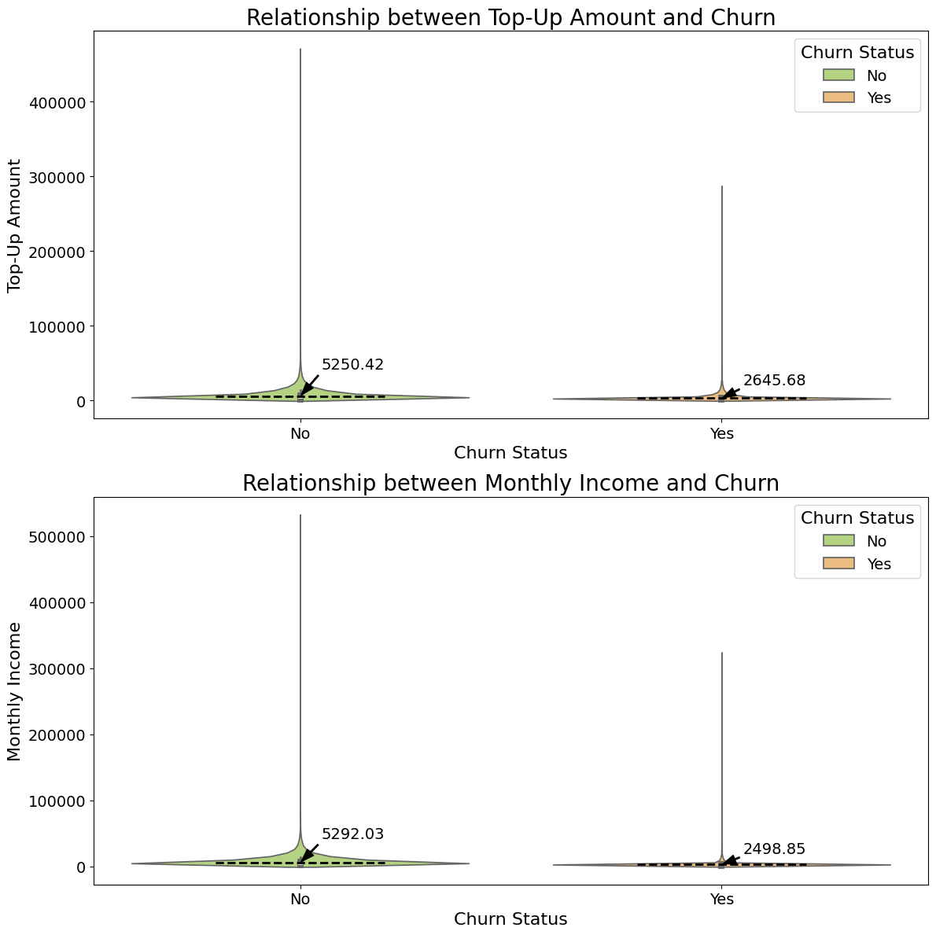
How do top-up amounts and monthly income relate to customer churn rates?
To understand whether variations in top-up amounts and monthly income are associated with higher or lower churn rates.

Slide 27
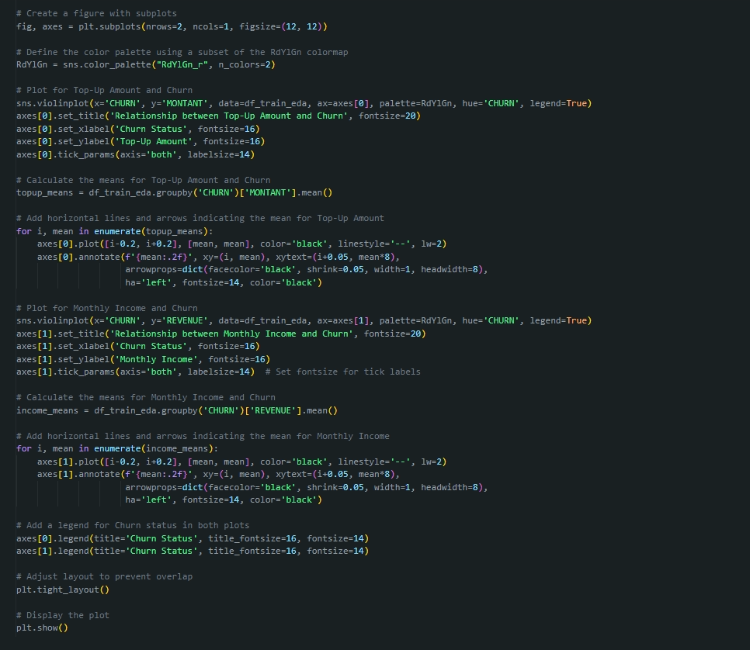
How do top-up amounts and monthly income relate to customer churn rates?

Slide 28
How do top-up amounts and monthly income relate to customer churn rates?

Slide 29
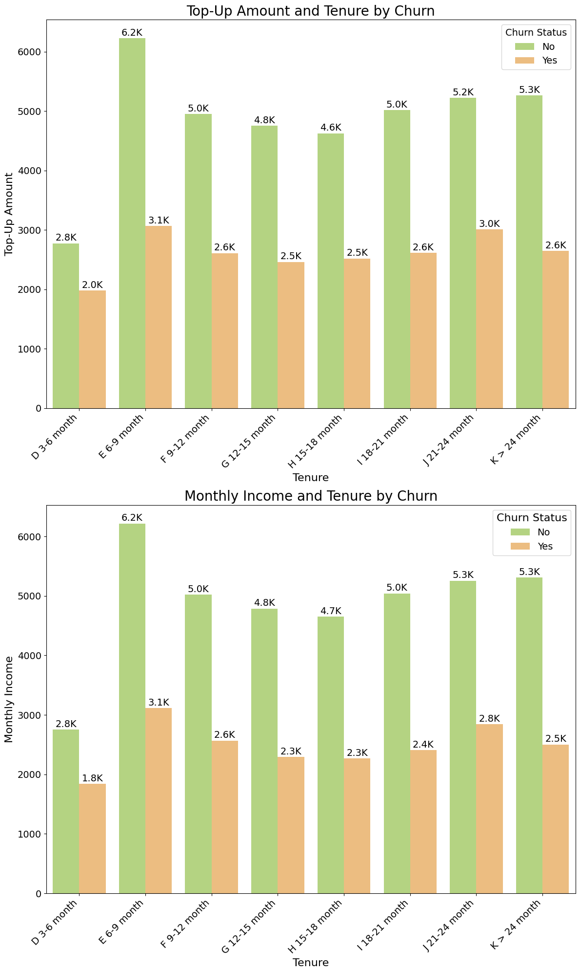
How does the top-up amount and monthly income vary across different tenures, and how does this variation relate to customer churn rates?
The purpose of this analysis is to understand how customer behaviour related to top-up amounts and monthly income changes as their tenure with the company progresses.

Slide 30
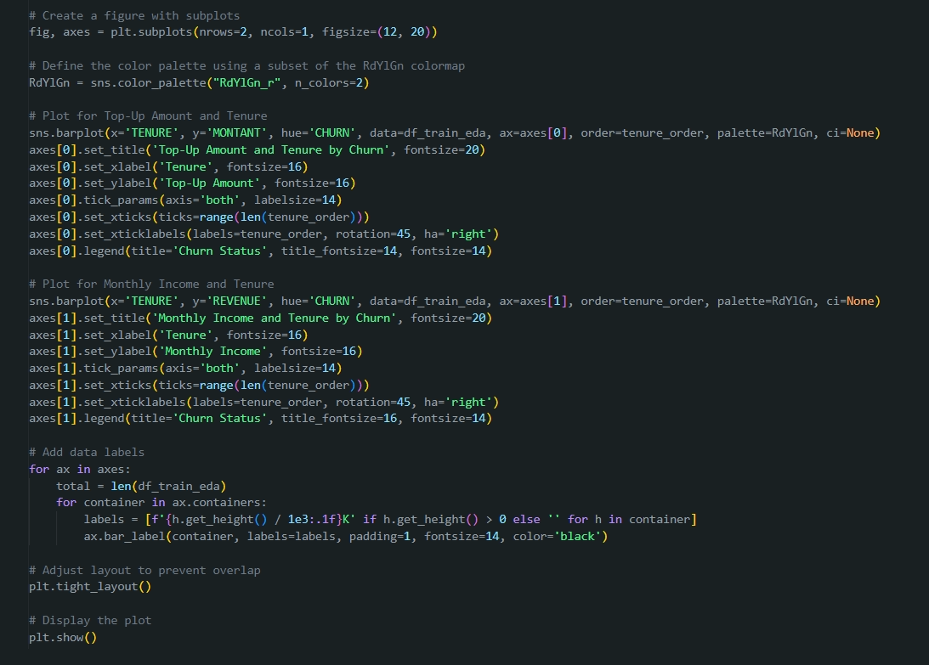
How does the top-up amount and monthly income vary across different tenures, and how does this variation relate to customer churn rates?

Slide 31
How does the top-up amount and monthly income vary across different tenures, and how does this variation relate to customer churn rates?

Slide 32
HYPOTHESIS TESTING

Slide 33
Ms. Jackline Wangari Maina

Slide 34
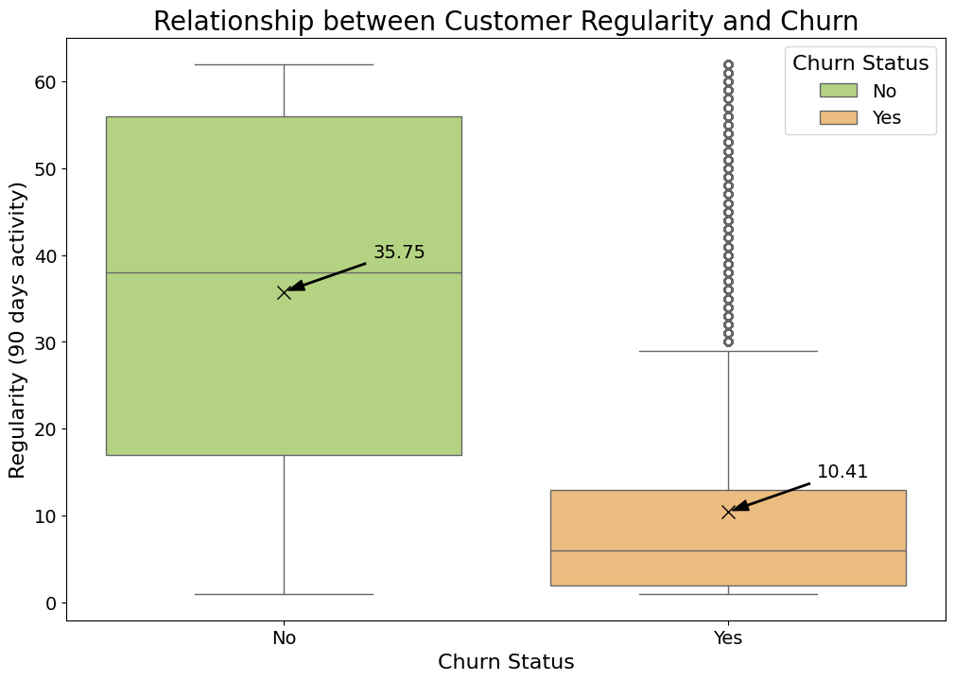
What is the relationship between customer regularity and churn?
To understand if customers with consistent activity over 90 days are less likely to churn, offering a measure of sustained engagement.

Slide 35
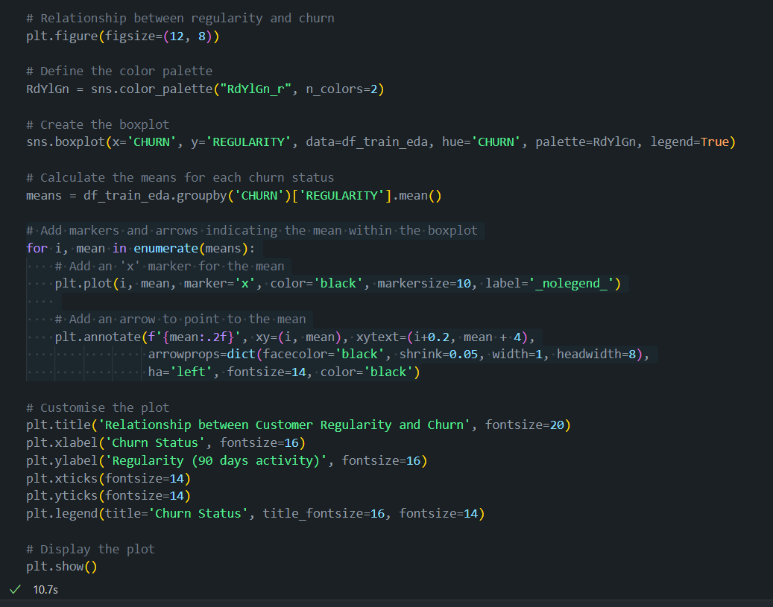
What is the relationship between customer regularity and churn?

Slide 36
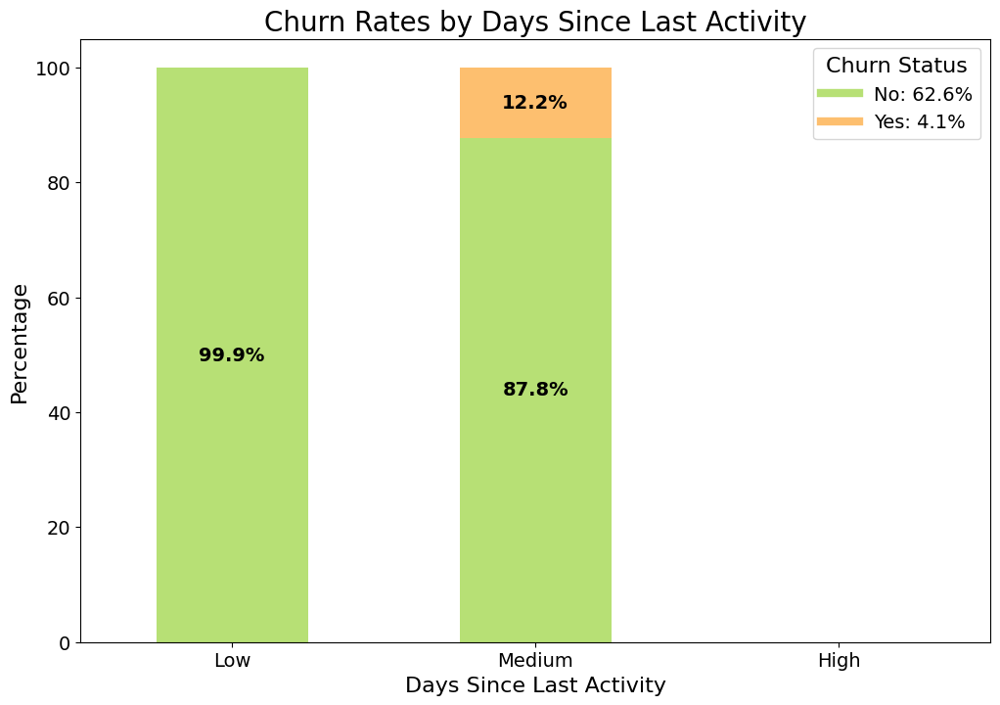
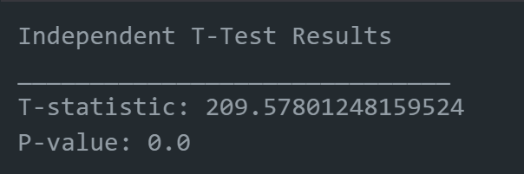
What is the likelihood of inactive customers churning?
Null Hypothesis (H₀)
There is no statistically significant relationship between churn rate and days_since_last_activity.
Alternative Hypothesis (H₁)
There is a statistically significant relationship between churn rate and days_since_last_activity.
p < 0.05

Slide 37
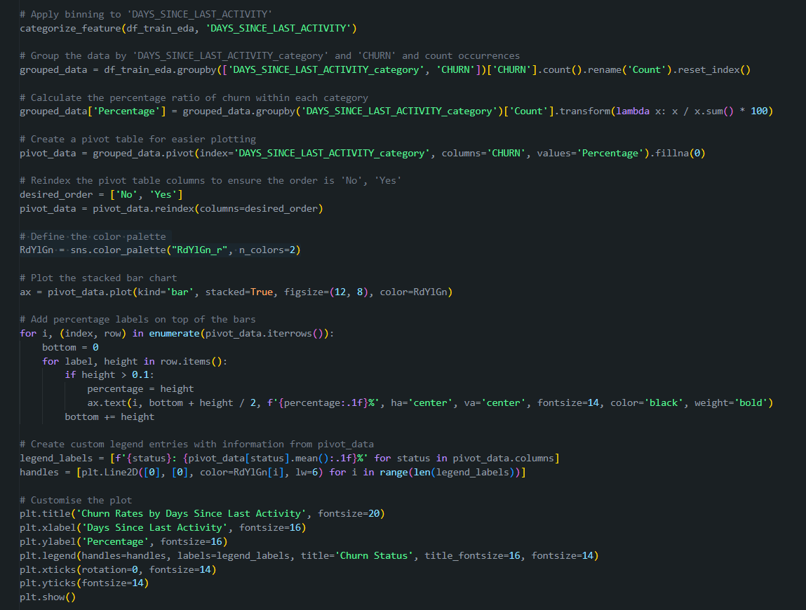
What is the likelihood of inactive customers churning?
Low: Values in the lower third of the data.
Medium: Values between the lower and higher thirds.
High: Values in the higher third of the data.

Slide 38
DATA PREPARATION

Slide 39
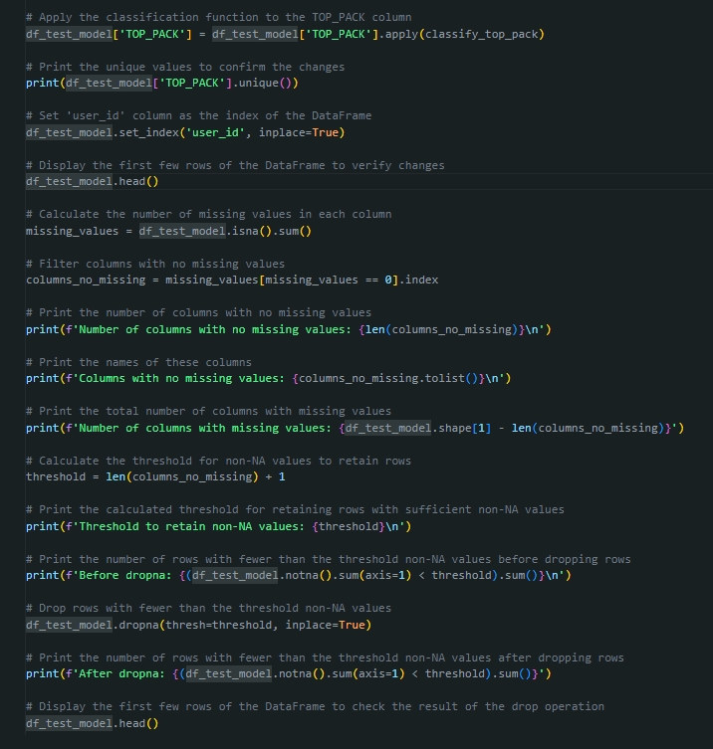
Dropping of Rows Based on Missing Data
Number of columns with no missing values: 4
Columns with no missing values: ['TENURE', 'MRG', 'REGULARITY', 'CHURN’]
Number of columns with missing values: 14

Slide 40
Classification of TOP_PACK

Slide 41
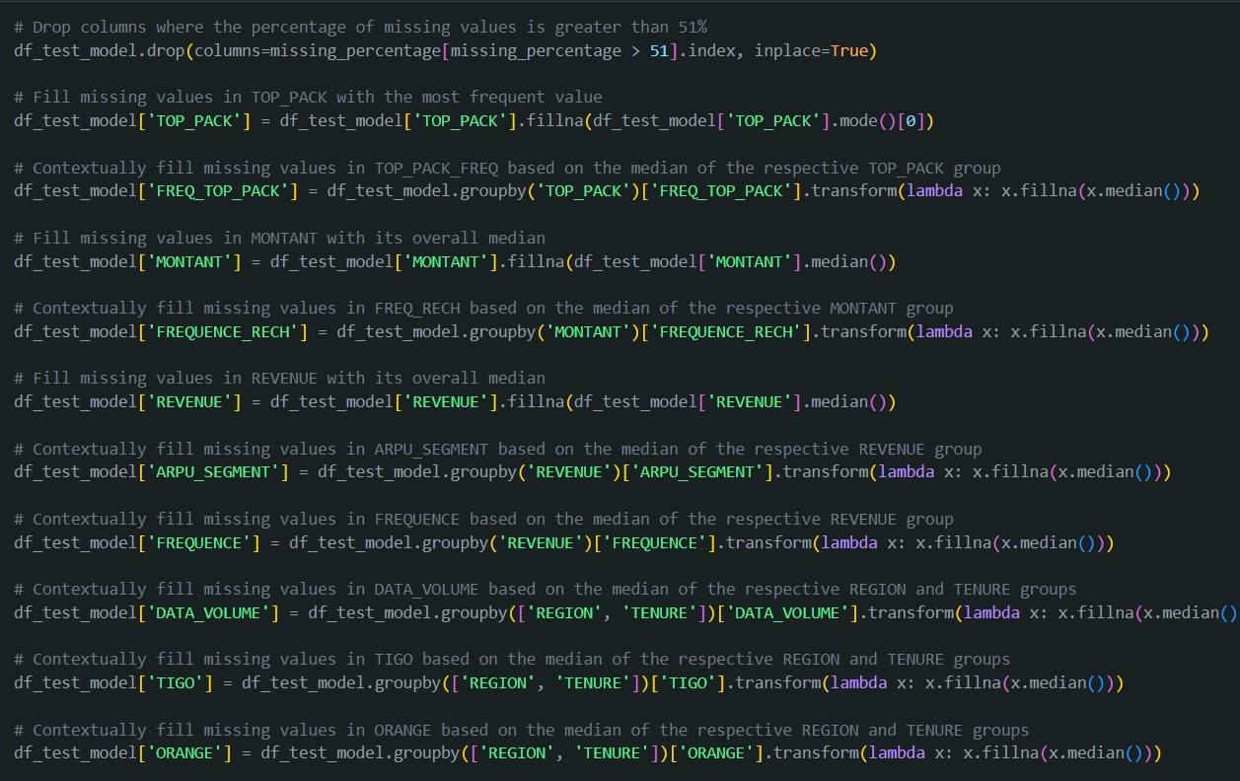
Column Handling and Imputation Strategy
Column Handling
Categorical and Numerical Imputation
Joint Median Imputation for Co-dependent Features
Contextual Imputation
Pipeline Handling for Remaining Missing Values

Slide 42
Further Data Processing for Modelling
01
05
Separate input features into numeric and categorical for different pipelines
Split data set into X and y
02
Split data set into training and evaluation
03
04
Feature Engineering
Create a pipeline to preprocess the data
Notes:
`Split data set into X and y`
`Split data set into training and evaluation`
`Feature Engineering (Craeting New Features, (binning & bucketing), Handling Missing Data, Encoding, Standardization, Normalization, Scaling)`
- Create a pipeline to preprocess the data
- Separate inpute features into numeric and categorical for different pipelines
- Handle missing values using imputation Techniques Use sklearn.impute.SimpleImputer
- Scaling or normalize numeric features: Use sklearn.preprocessing.StandardScaler to scale the numerical features
- Encode categorical features: Use OneHotEncoder to encode categorical features
- Transformations for skewed data (log, power, custom, etc)
- Balance dataset (depending on what you see): Use sklearn.utils.resample to balance the dataset and or use Over-sampling/Under-sampling methods, more details here: https://imbalanced-learn.org/stable/install.html
`Features Creation`

Slide 43
MODELLING AND EVALUATION

Slide 44
Mr. Nfayem Imoro

Slide 45
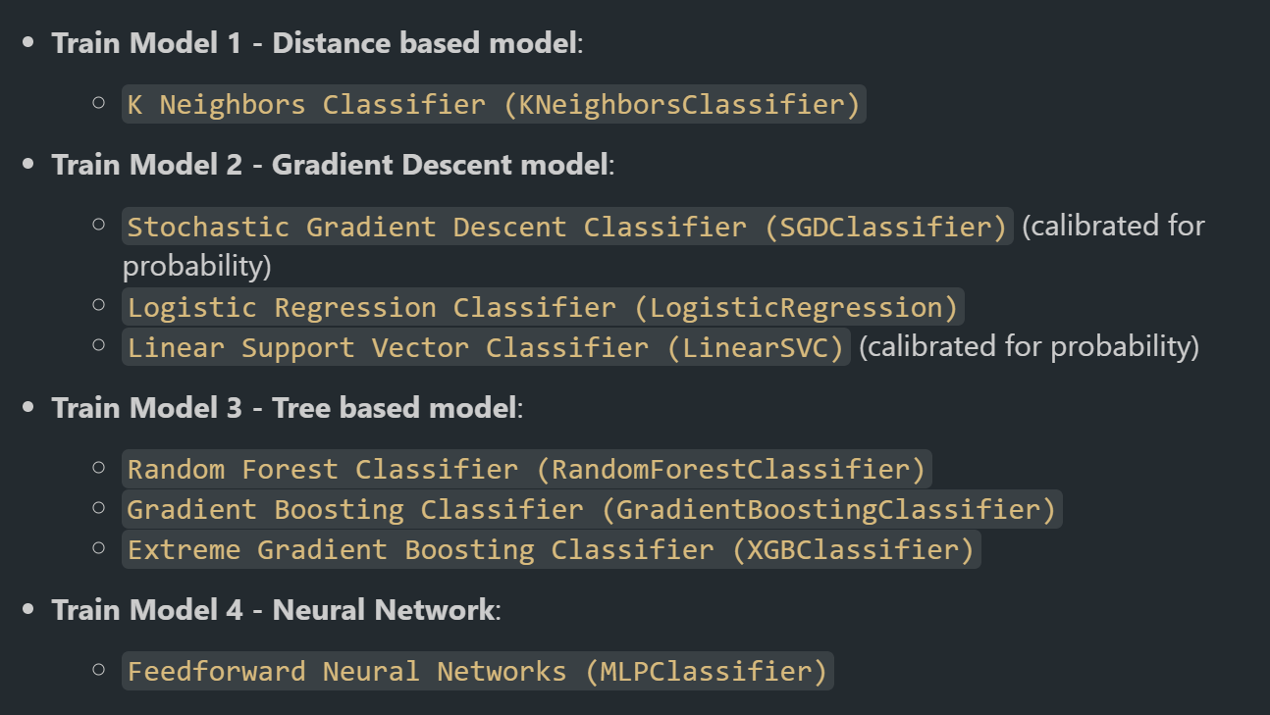
Models

Slide 46
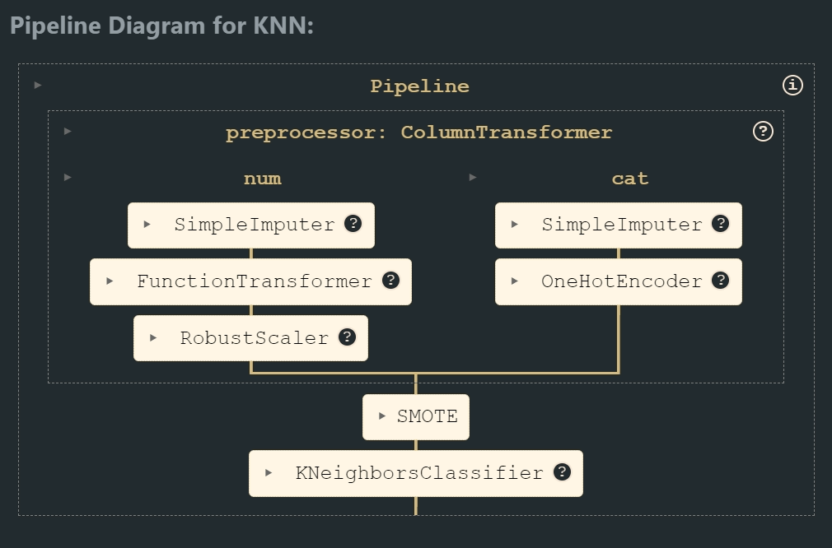
Pipeline Structure

Slide 47
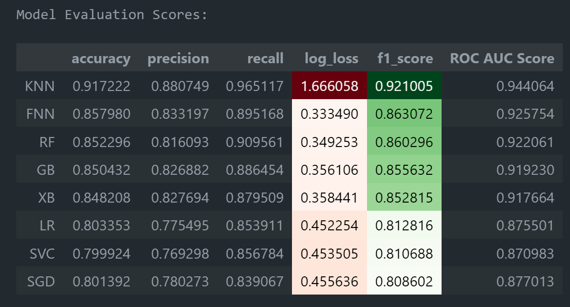
Model Evaluation Scores of Original Dataset

Slide 48
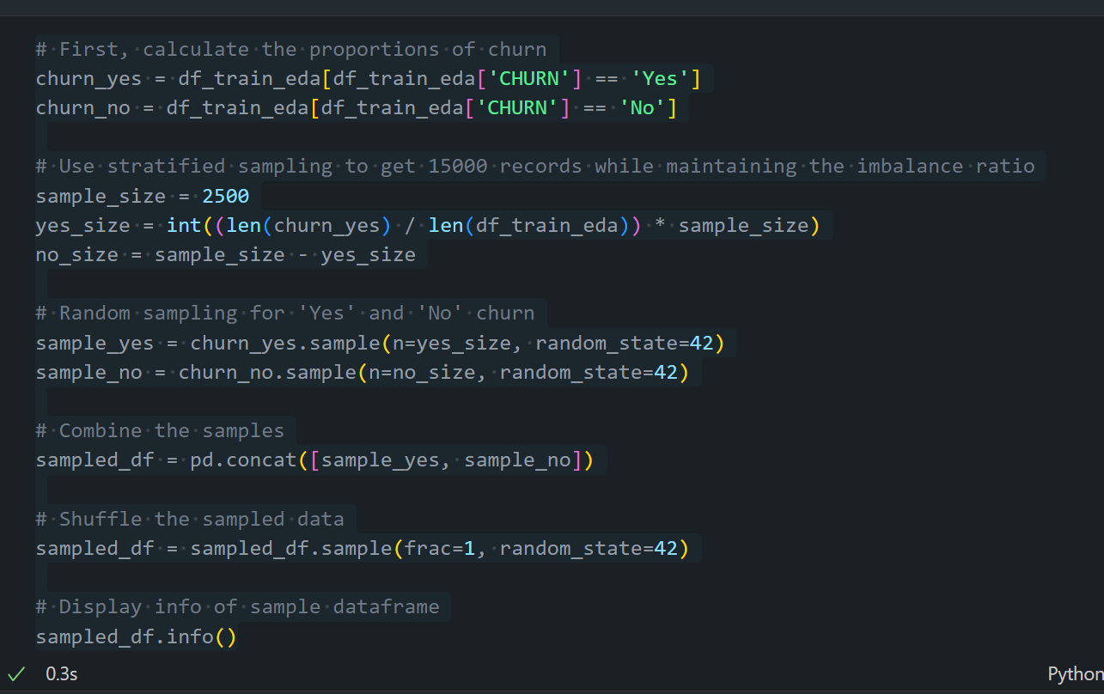
Modelling Challenges
Large Dataset
Computationally expensive Hyperparameter Tuning

Slide 49
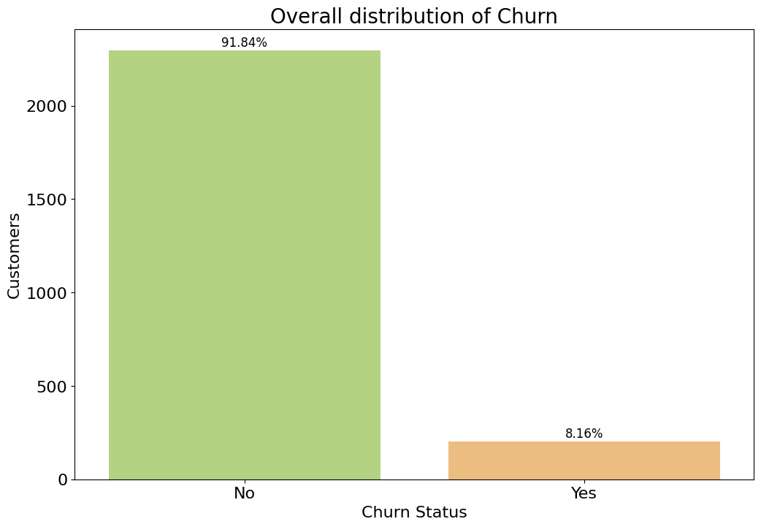
Modelling Challenges
ORIGINAL DATASET
SAMPLED DATASET

Slide 50
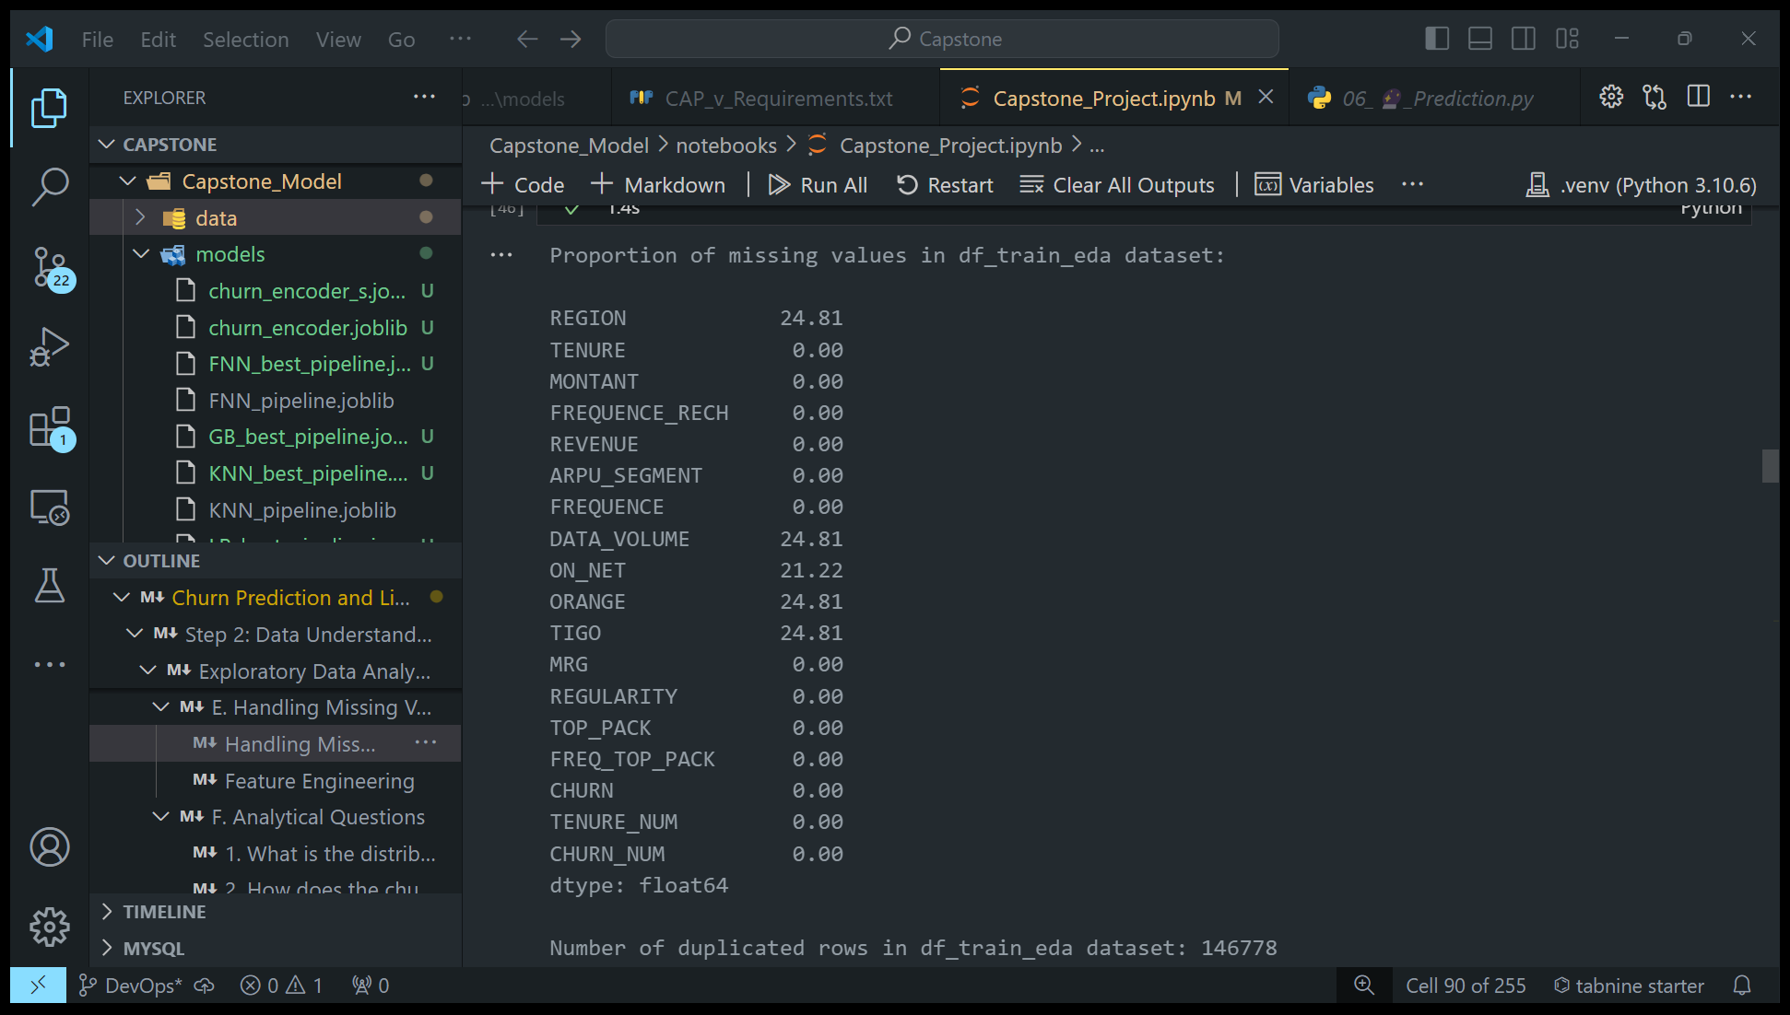
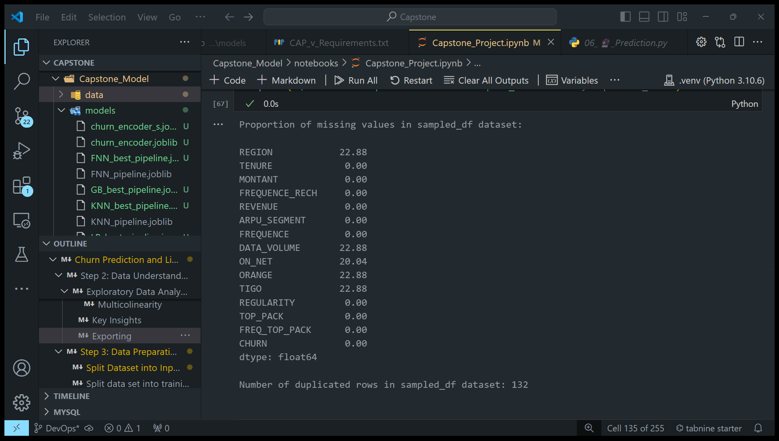
Modelling Challenges
ORIGINAL DATASET
SAMPLED DATASET

Slide 51
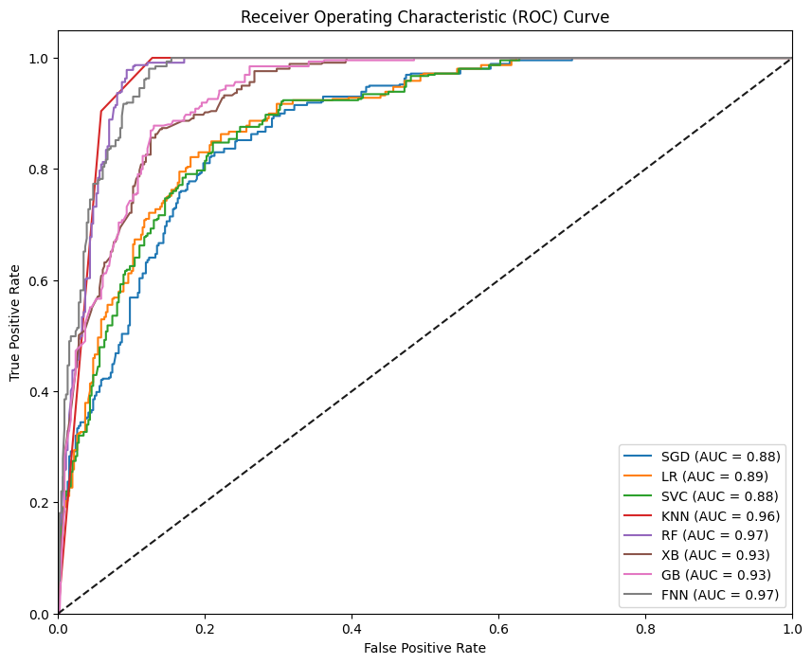
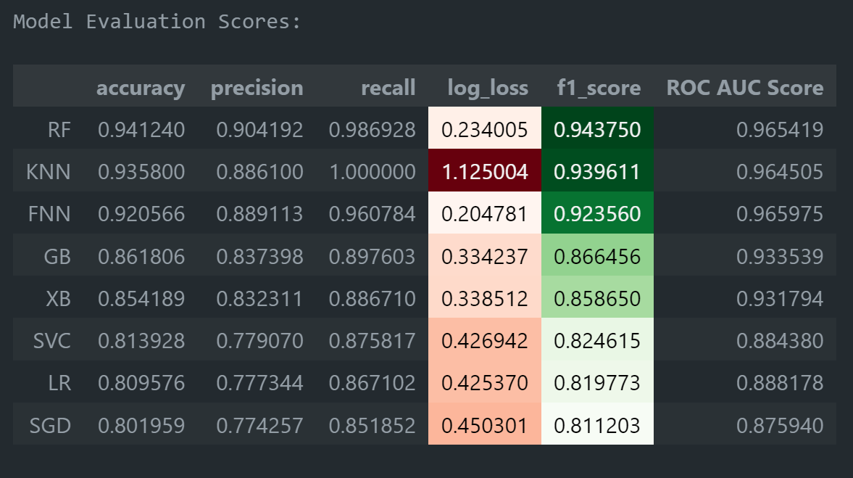
Model Evaluation Scores and ROC of Sampled Dataset

Slide 52
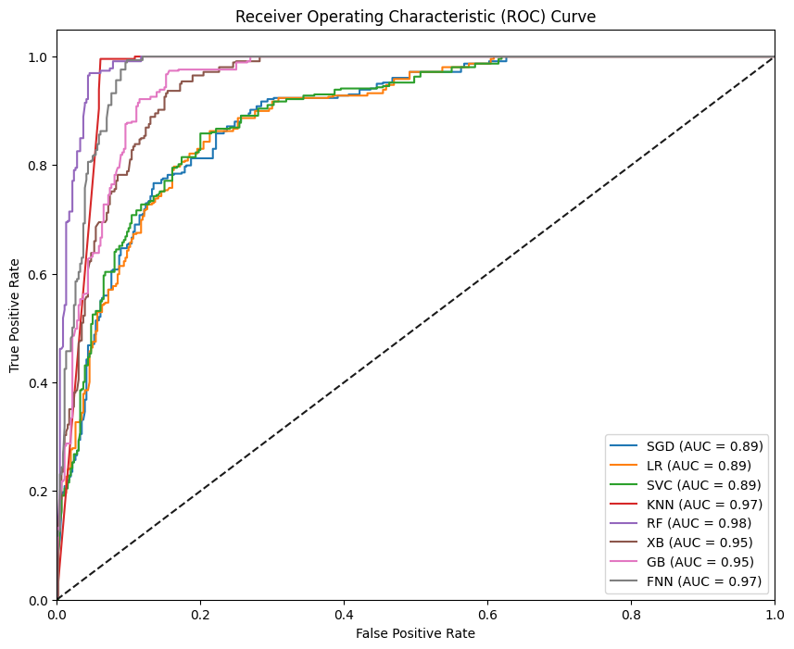
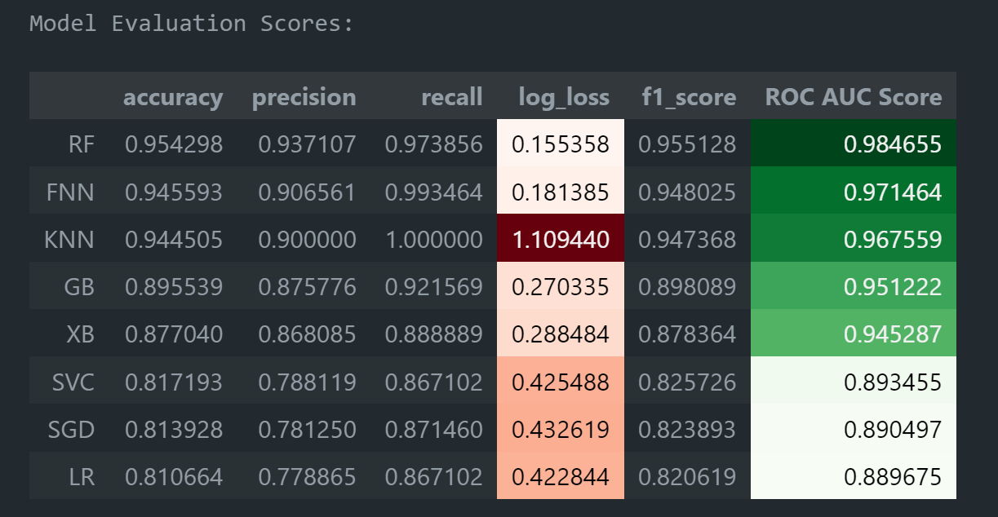
Hyperparameter Tuning

Slide 53
MODEL TESTING

Slide 54
Mr. Gabriel Kuma Koku

Slide 55
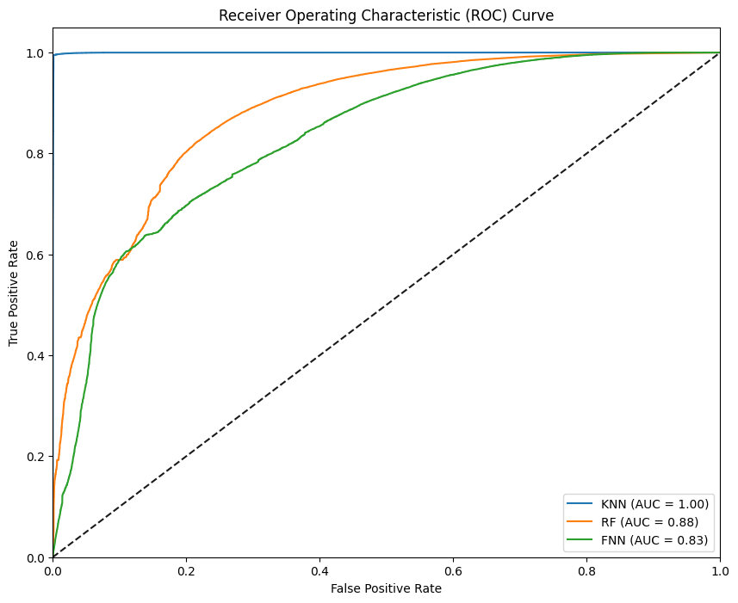
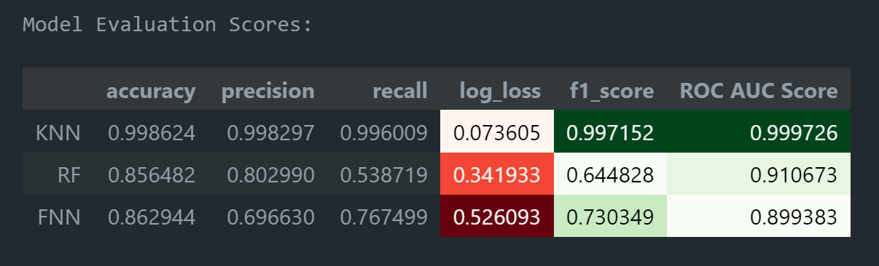
Model Evaluation Scores and ROC of Test Dataset

Slide 56
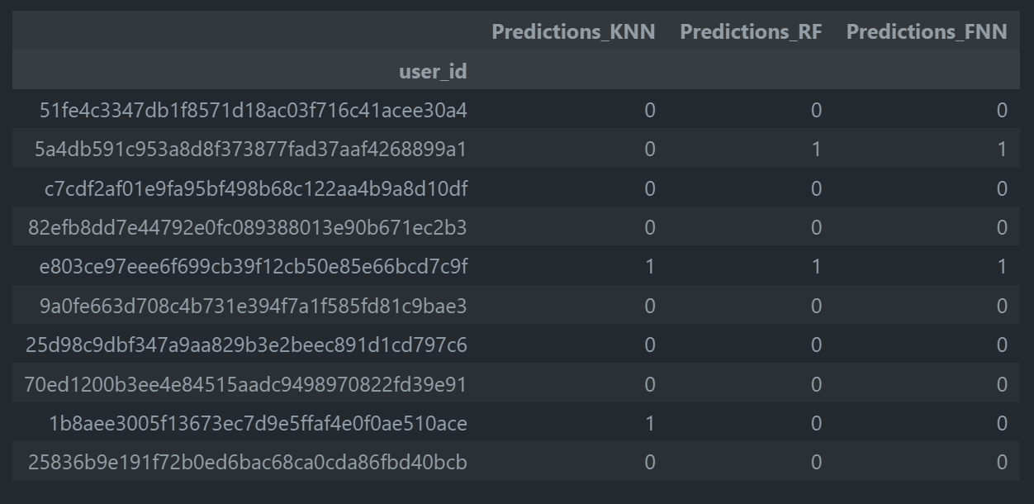
Model Predictions of Test Dataset

Slide 57
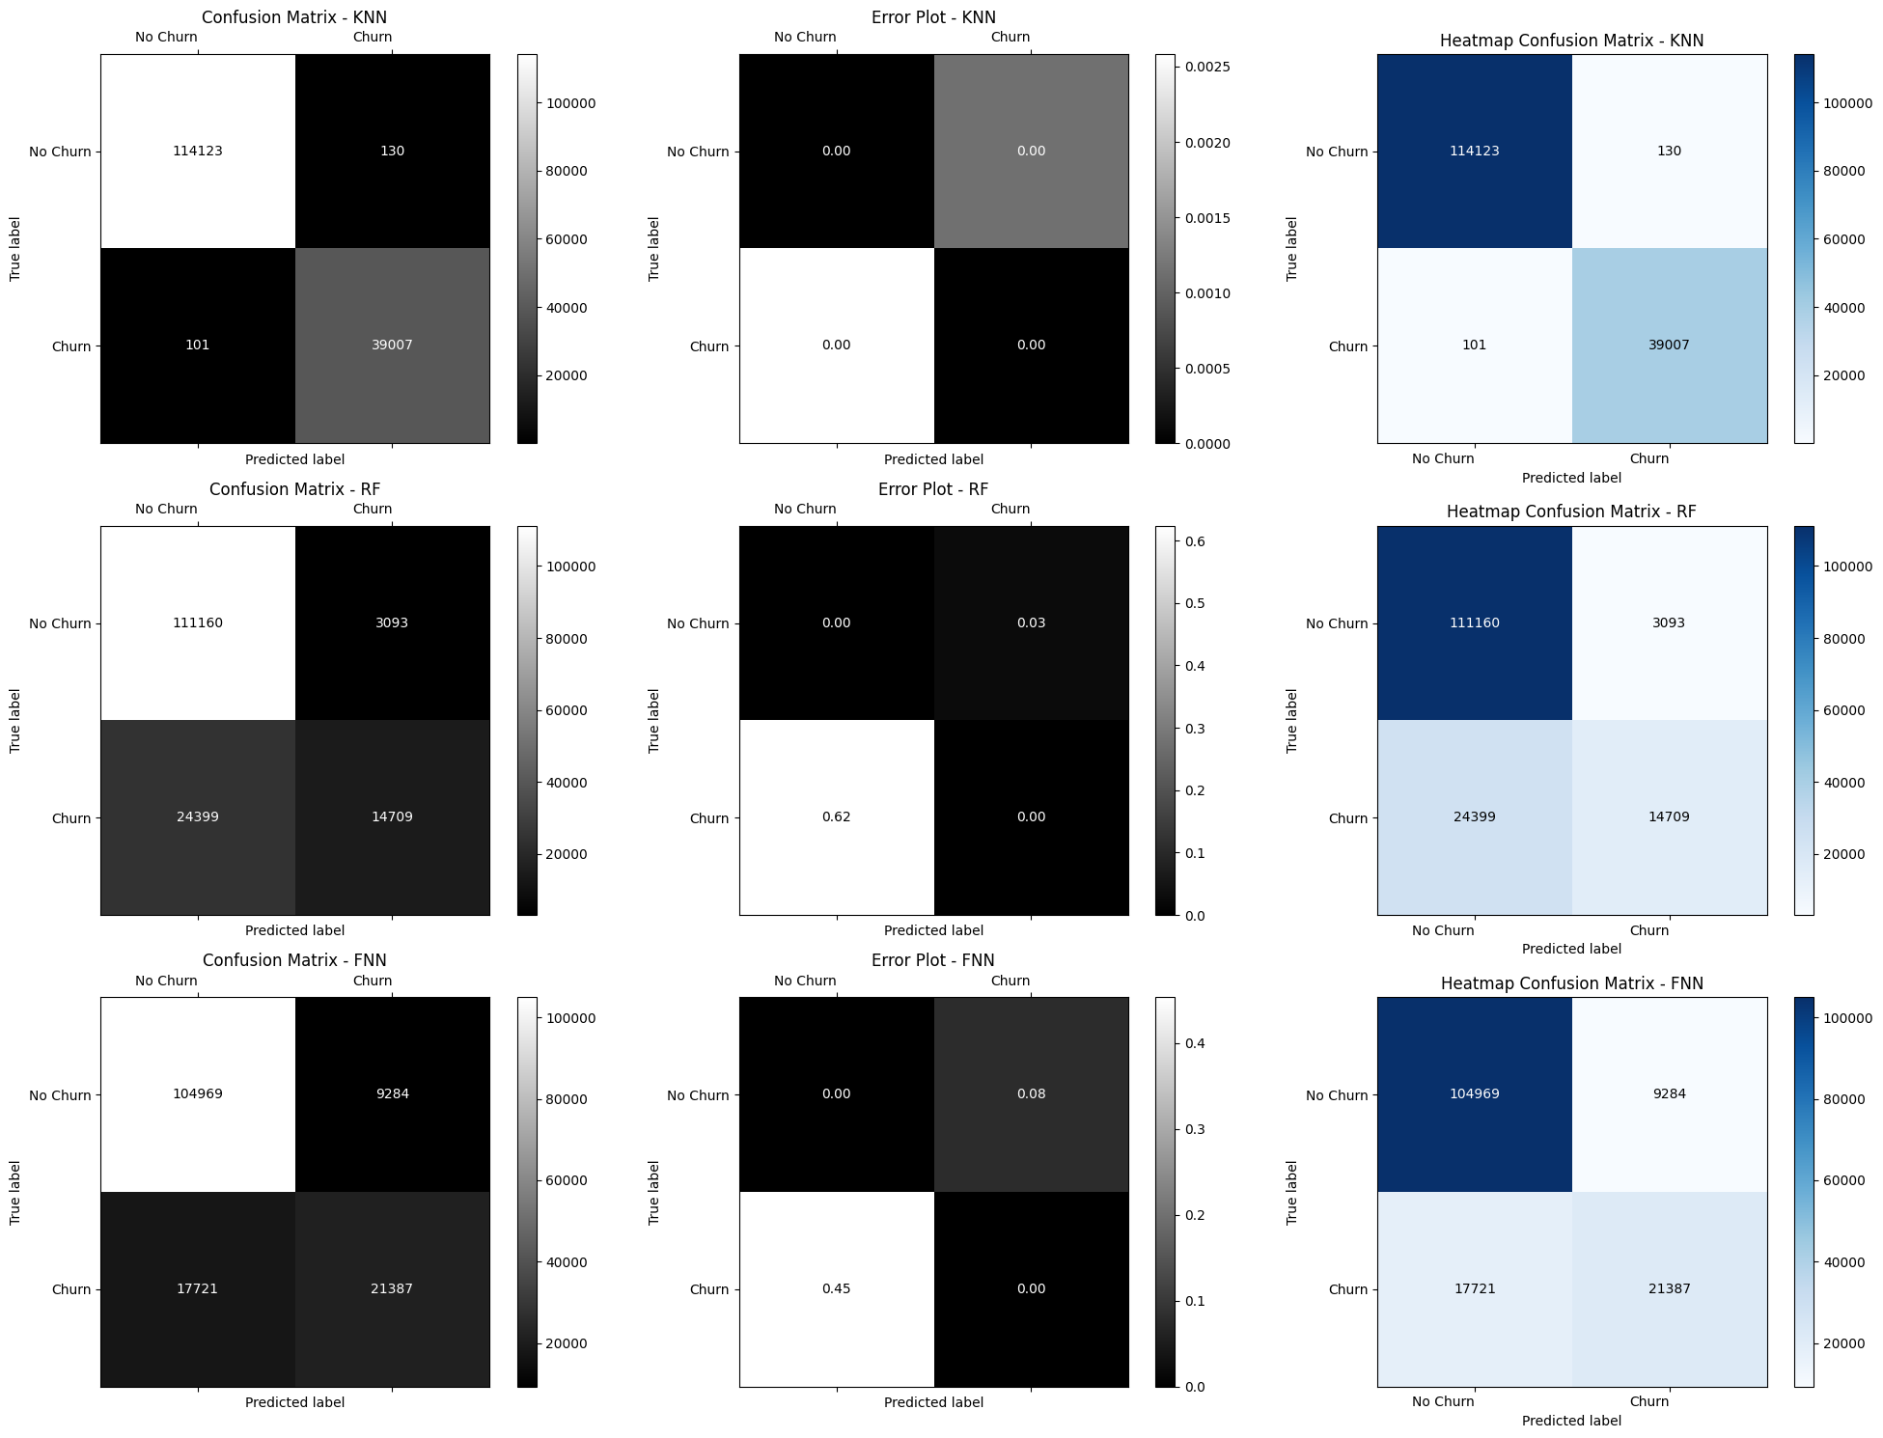
KNN Confusion Matrix for Test Dataset

Slide 58
RF Confusion Matrix for Test Dataset

Slide 59
FNN Confusion Matrix for Test Dataset

Slide 60
MODEL DEPLOYMENT
(CHURN PREDICTOR APP)

Slide 61
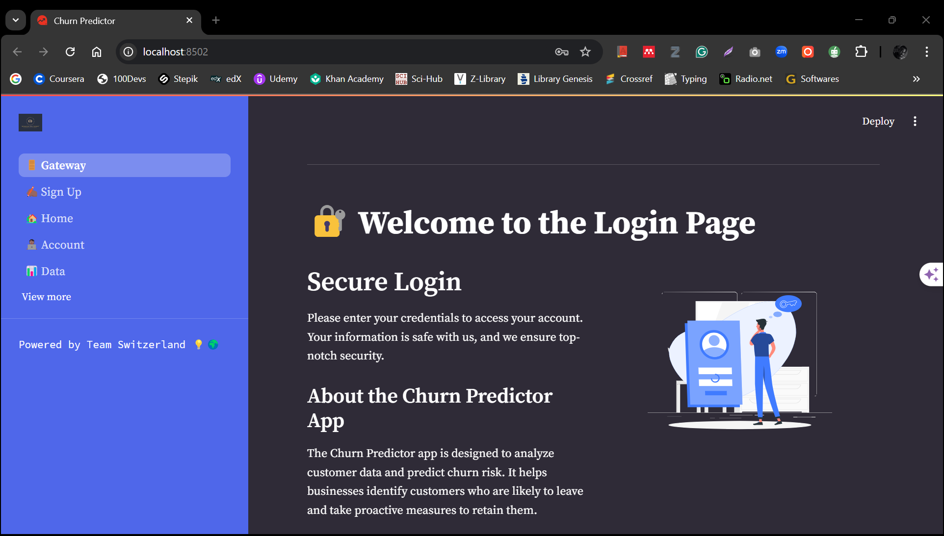
Welcome Page

Slide 62
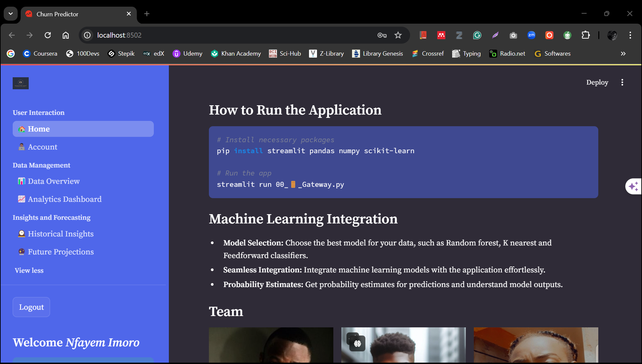
Home Page

Slide 63
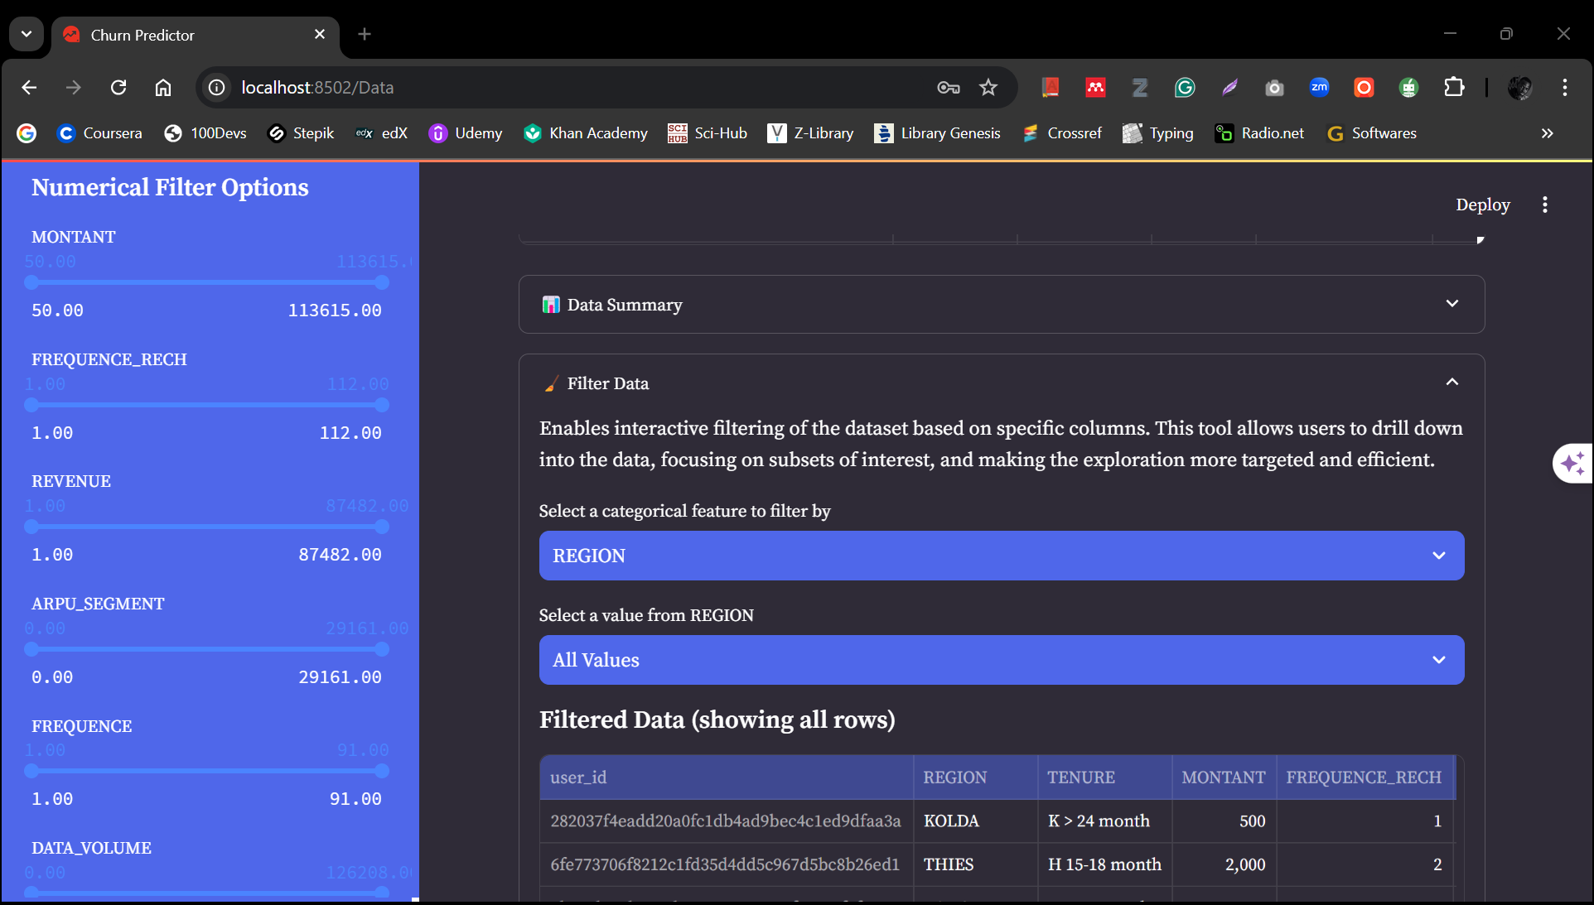
Data Page

Slide 64
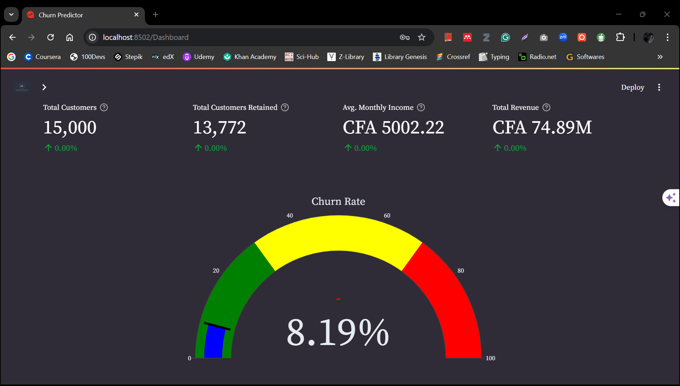
Dashboard Page

Slide 65
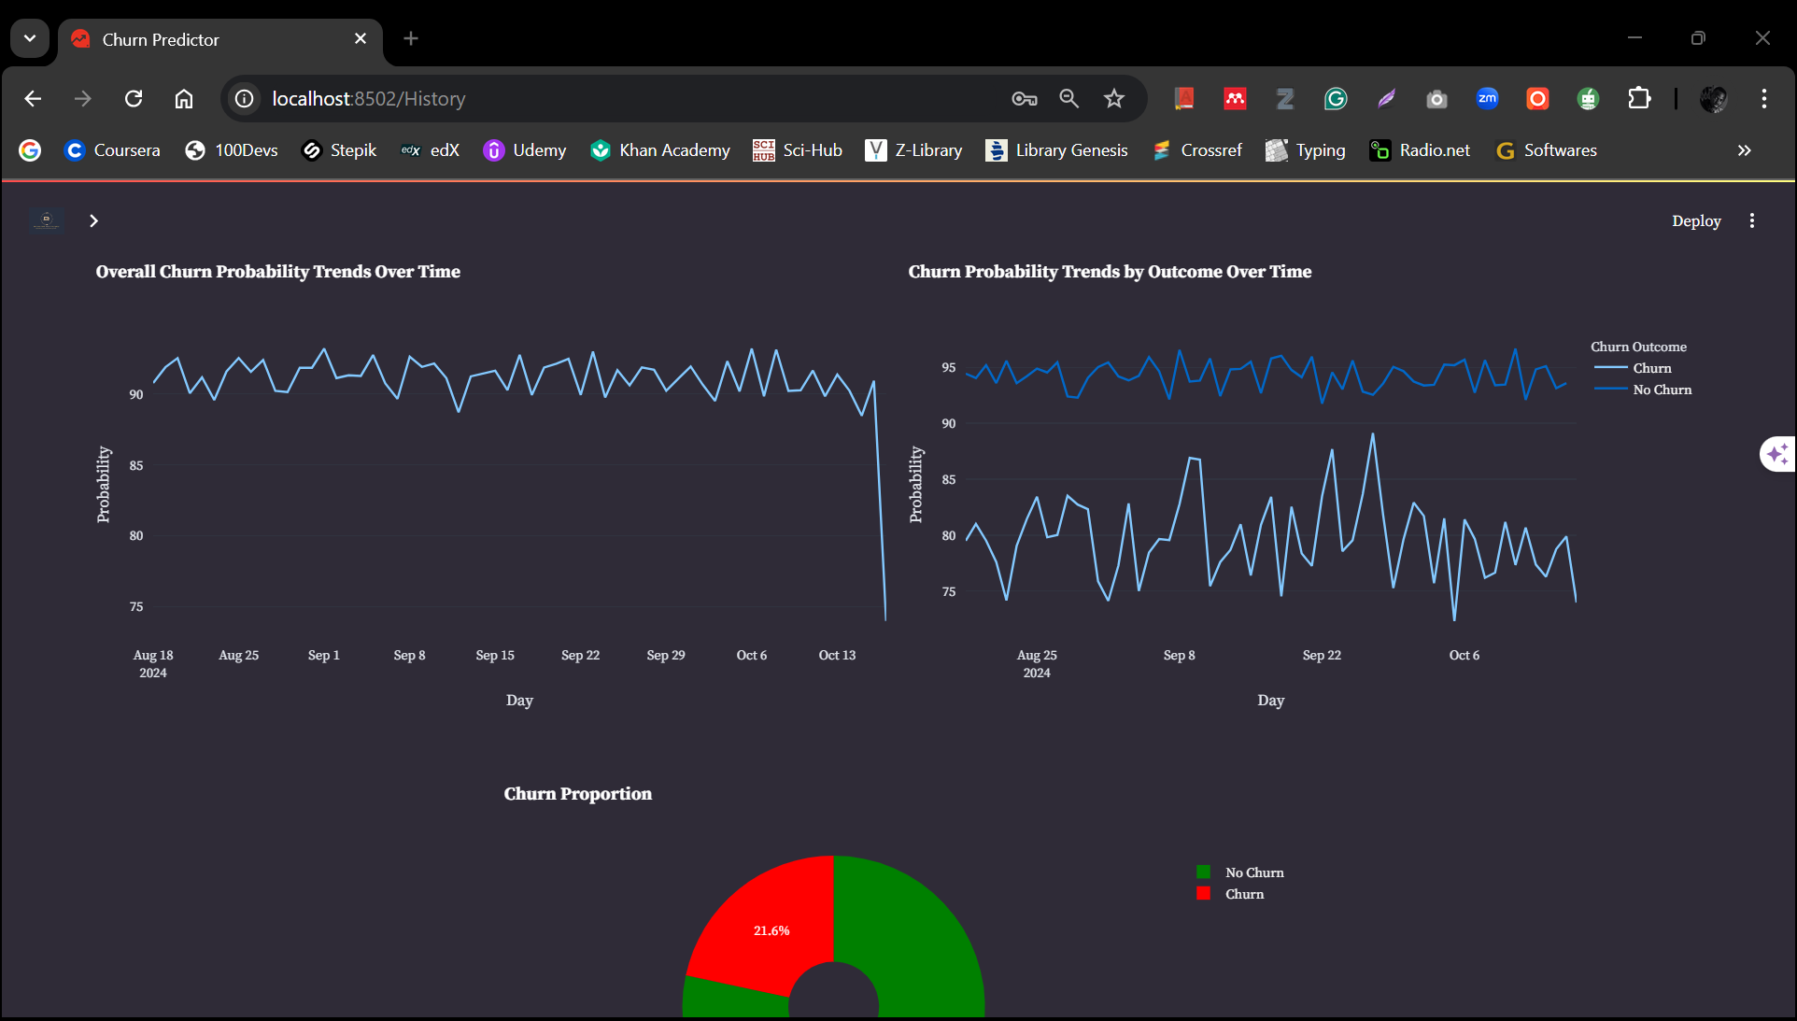
History Page

Slide 66
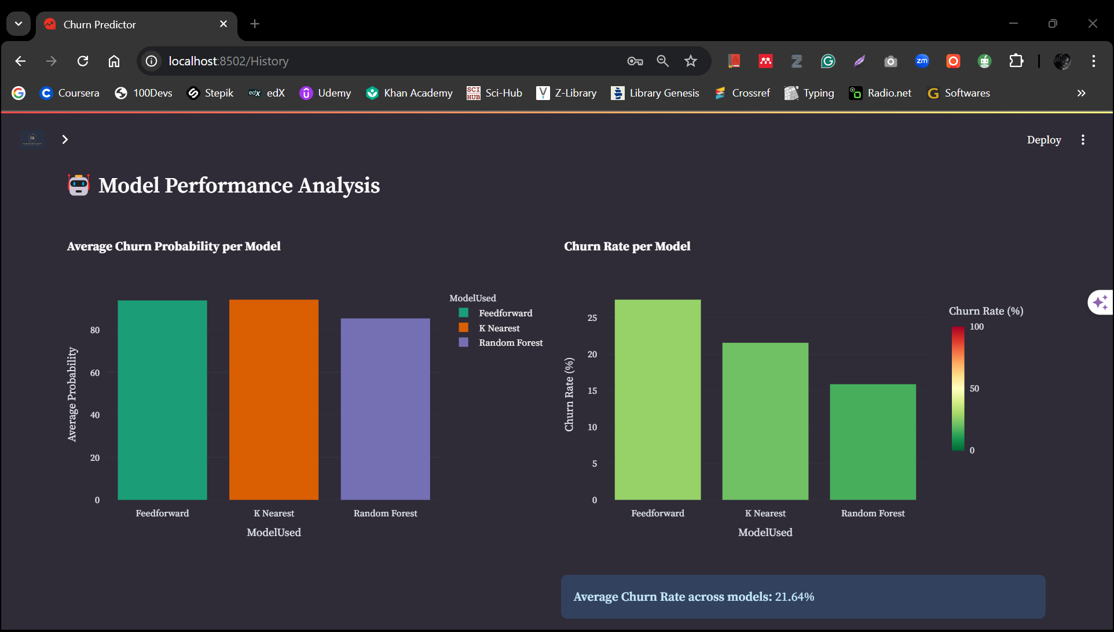
History Page

Slide 67
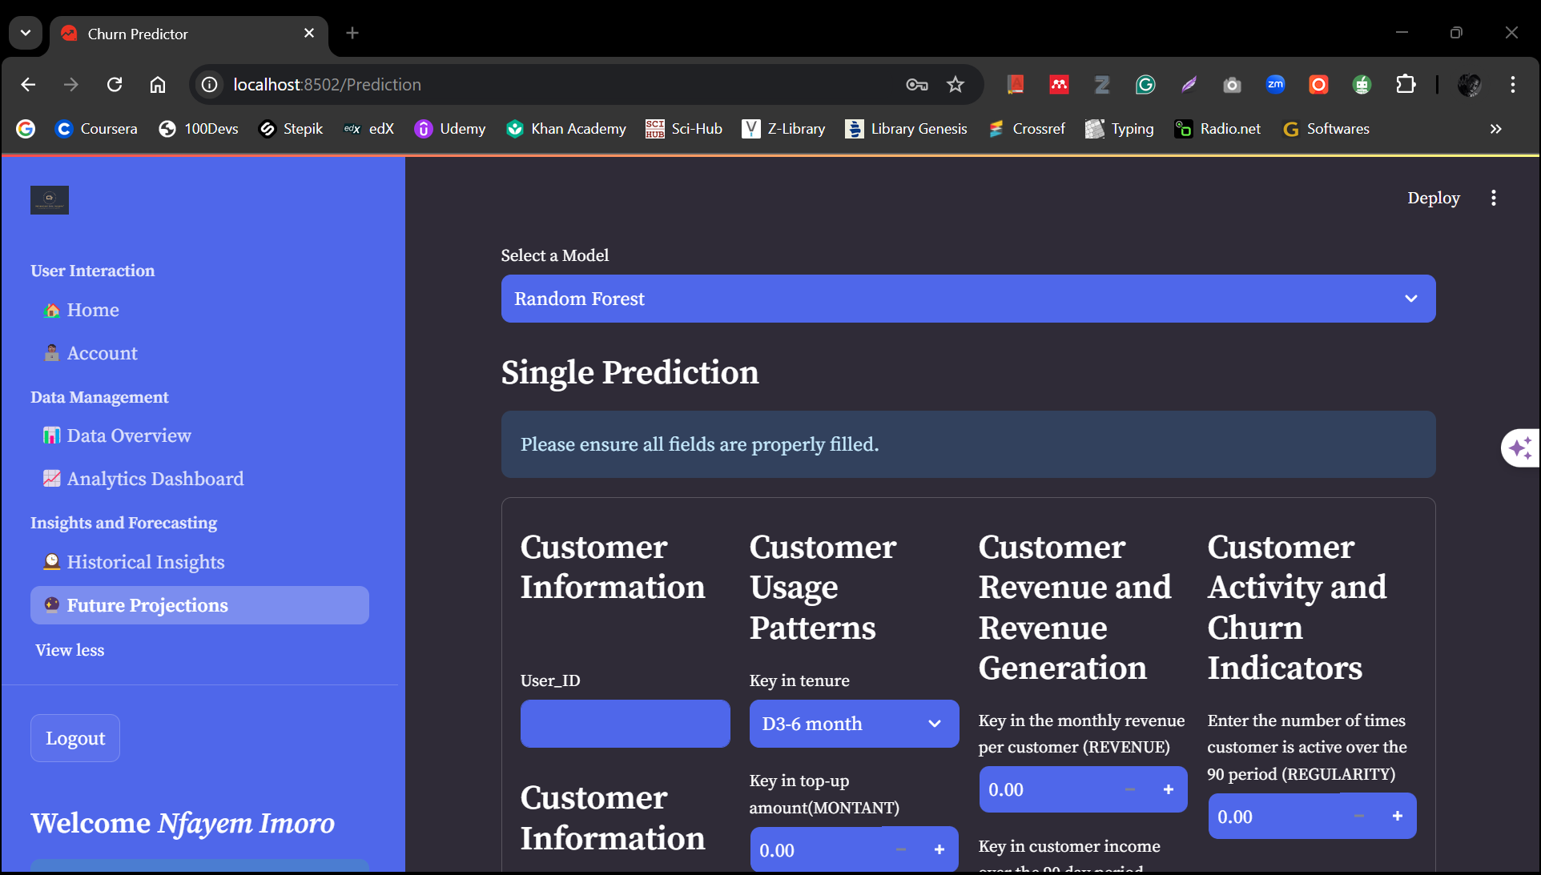
Prediction Page

Slide 68
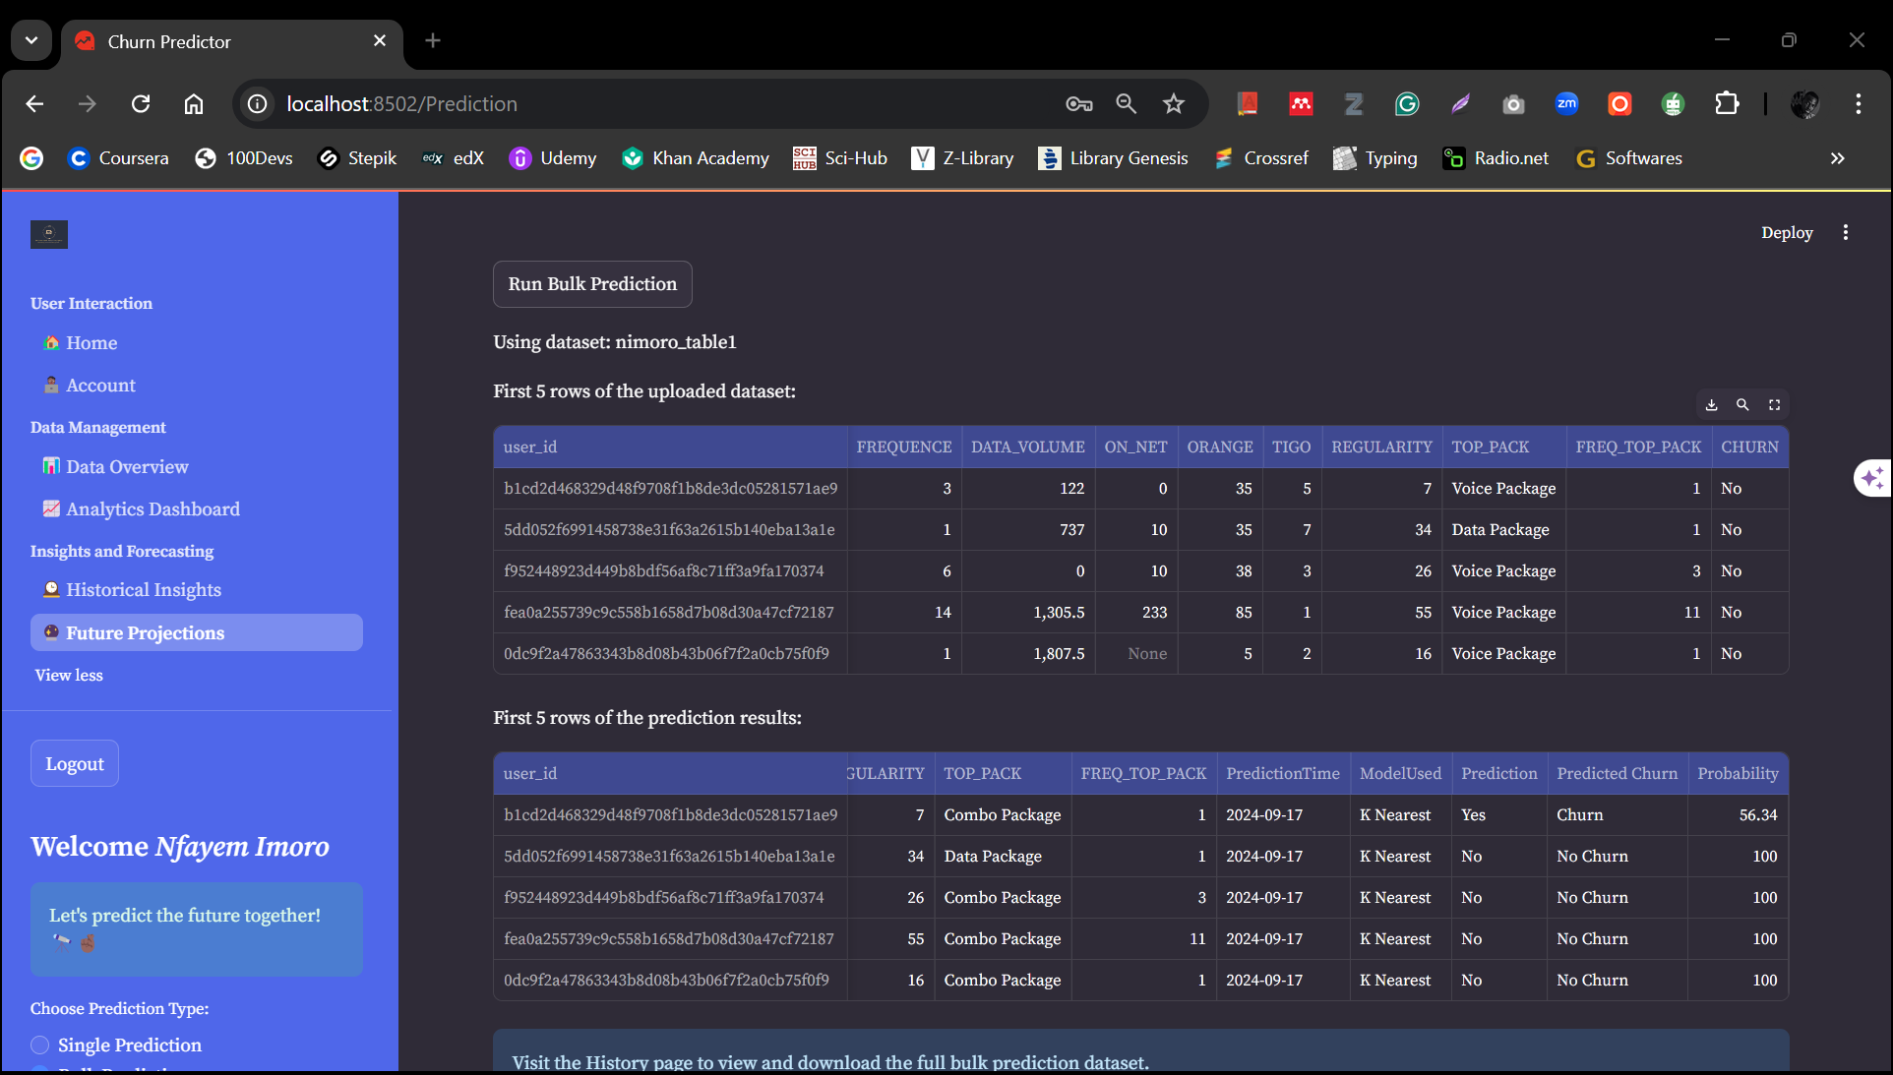
Prediction Page

Slide 69

Relevant Links
Link to GitHub Repository
Link to Deployed Application

Slide 70
Azubian Expresso Challenge
Powered By Team Switzerland
THANK YOU

